Slide 1
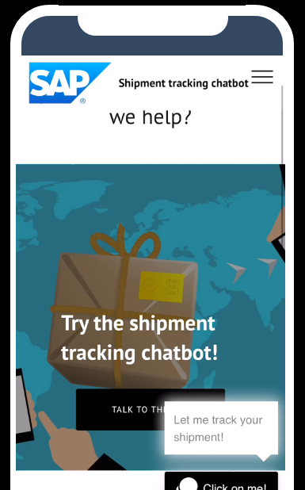

How to use this slide deck – delete this slide before presentations
This slide deck is intended for external use except for the slides and sections that are explicitly marked internal.
The yellow boxes should be deleted before presenting as they are solely containing further information and links for SAP colleagues presenting SAP Conversational AI.
For embedded videos (e.g. slide 34), please switch to presenter mode. This might be also the reason why it make take some time to download the presentation.
Please always delete the videos and convert to pdf before sending it externally.
PUBLIC
Download from Demostore

Slide 2

Build Powerful Conversational Interfaces With
SAP Conversational AI
Speaker’s Name, SAP
Month 00, 2020
Notes:
Conversational interfaces are going to transform the life of your employees by providing a incredible interface for your employees, therefore increasing your productivity, quality of worklife, and overall success. SAP CAI is the one partner that will drive you to success.

Slide 3
Notes:
Explain our legal disclaimer

Slide 4



The world is turning conversational
67% of people expect to message with businesses more over the next two years – Facebook Insights
67% of consumers worldwide used a conversational interface for customer support in the past year - MCC
Notes:
https://www.gartner.com/imagesrv/summits/docs/na/customer-360/C360_2011_brochure_FINAL.pdf
https://insights.fb.com/morethanamessage/
https://www.michaelmanagement.com/blog/a-look-at-conversational-ai

Slide 5


This shift impacts your two most important audiences, and you need to act
Your customers
Your employees

Slide 6

Employee experience
Transform the work life of your employees

Slide 7

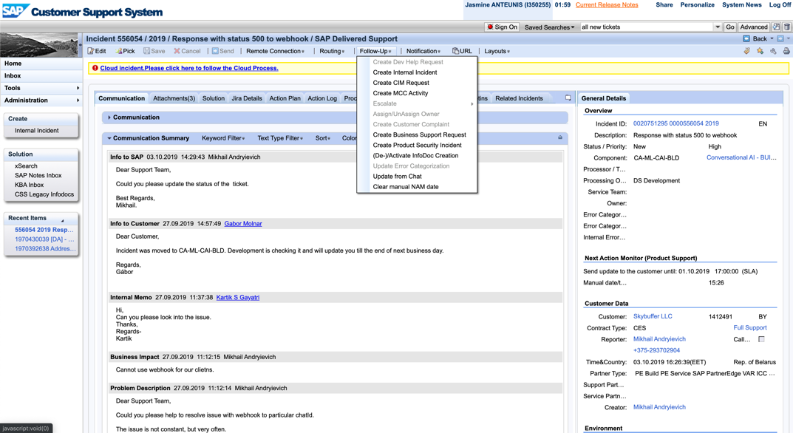
ENterprise software has very rich solutions that can be complex to use for employees!
Notes:
67% of consumers worldwide used a chatbot for customer support in the past year

Slide 8



A poor employee experience creates
Frustrated employees
Lower productivity
Has-been image
Notes:
67% of consumers worldwide used a chatbot for customer support in the past year

Slide 9



The solution? Use chatbots to HELP USERS
Reach the right page
on the interface
Answer FAQs
Execute
low-value tasks
Notes:
Insurance, order tracking, routing, premium account, etc!

Slide 10
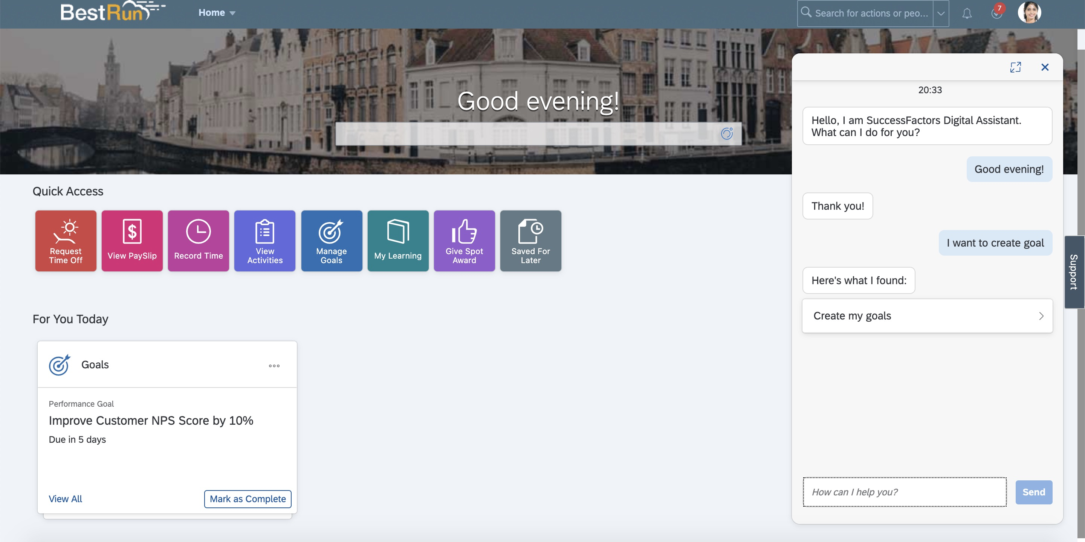
SAP IS AUGMENTING
its products with chatbots
All major SAP products are integrating chatbots available directly on the solution interface, capable of:
Guiding the user to the right page
Answering FAQ
Execute simple tasks

Slide 11
All SAP bots will be customizable to fit the unique needs of your company
If you have adapted SAP solutions to your own processes, you can do the exact same with the chatbot.
You can use the same tool that was used to build the SAP bots to customize them to your needs: our Bot Building Platform.

Slide 12
All bots are integrated into one unique interface: SAP’S Digital Assistant
Instead of having to chat to specific solution bots, we’re regrouping them all into one digital assistant.
Employees can ask any SAP related questions and get an answer!
Notes:
Insurance, order tracking, routing, premium account, etc!

Slide 13


Oh, and also, you want to automate non-SAP processes with bots?
Build any use cases with our
Bot Building Platform from A to Z
Integrate them seamlessly into
the SAP Digital Assistant
Notes:
Insurance, order tracking, routing, premium account, etc!

Slide 14


WHY US? SAP NATIVENESS!
Native low-code connections
SAP Conversational AI is native to the SAP ecosystem and can be easily connected to other SAP solutions
SAP business content
SAP provides standard bots for SAP products that customers can customize and expand. Don’t start from scratch, save 1+ year of development!
Notes:
Insurance, order tracking, routing, premium account, etc!

Slide 15
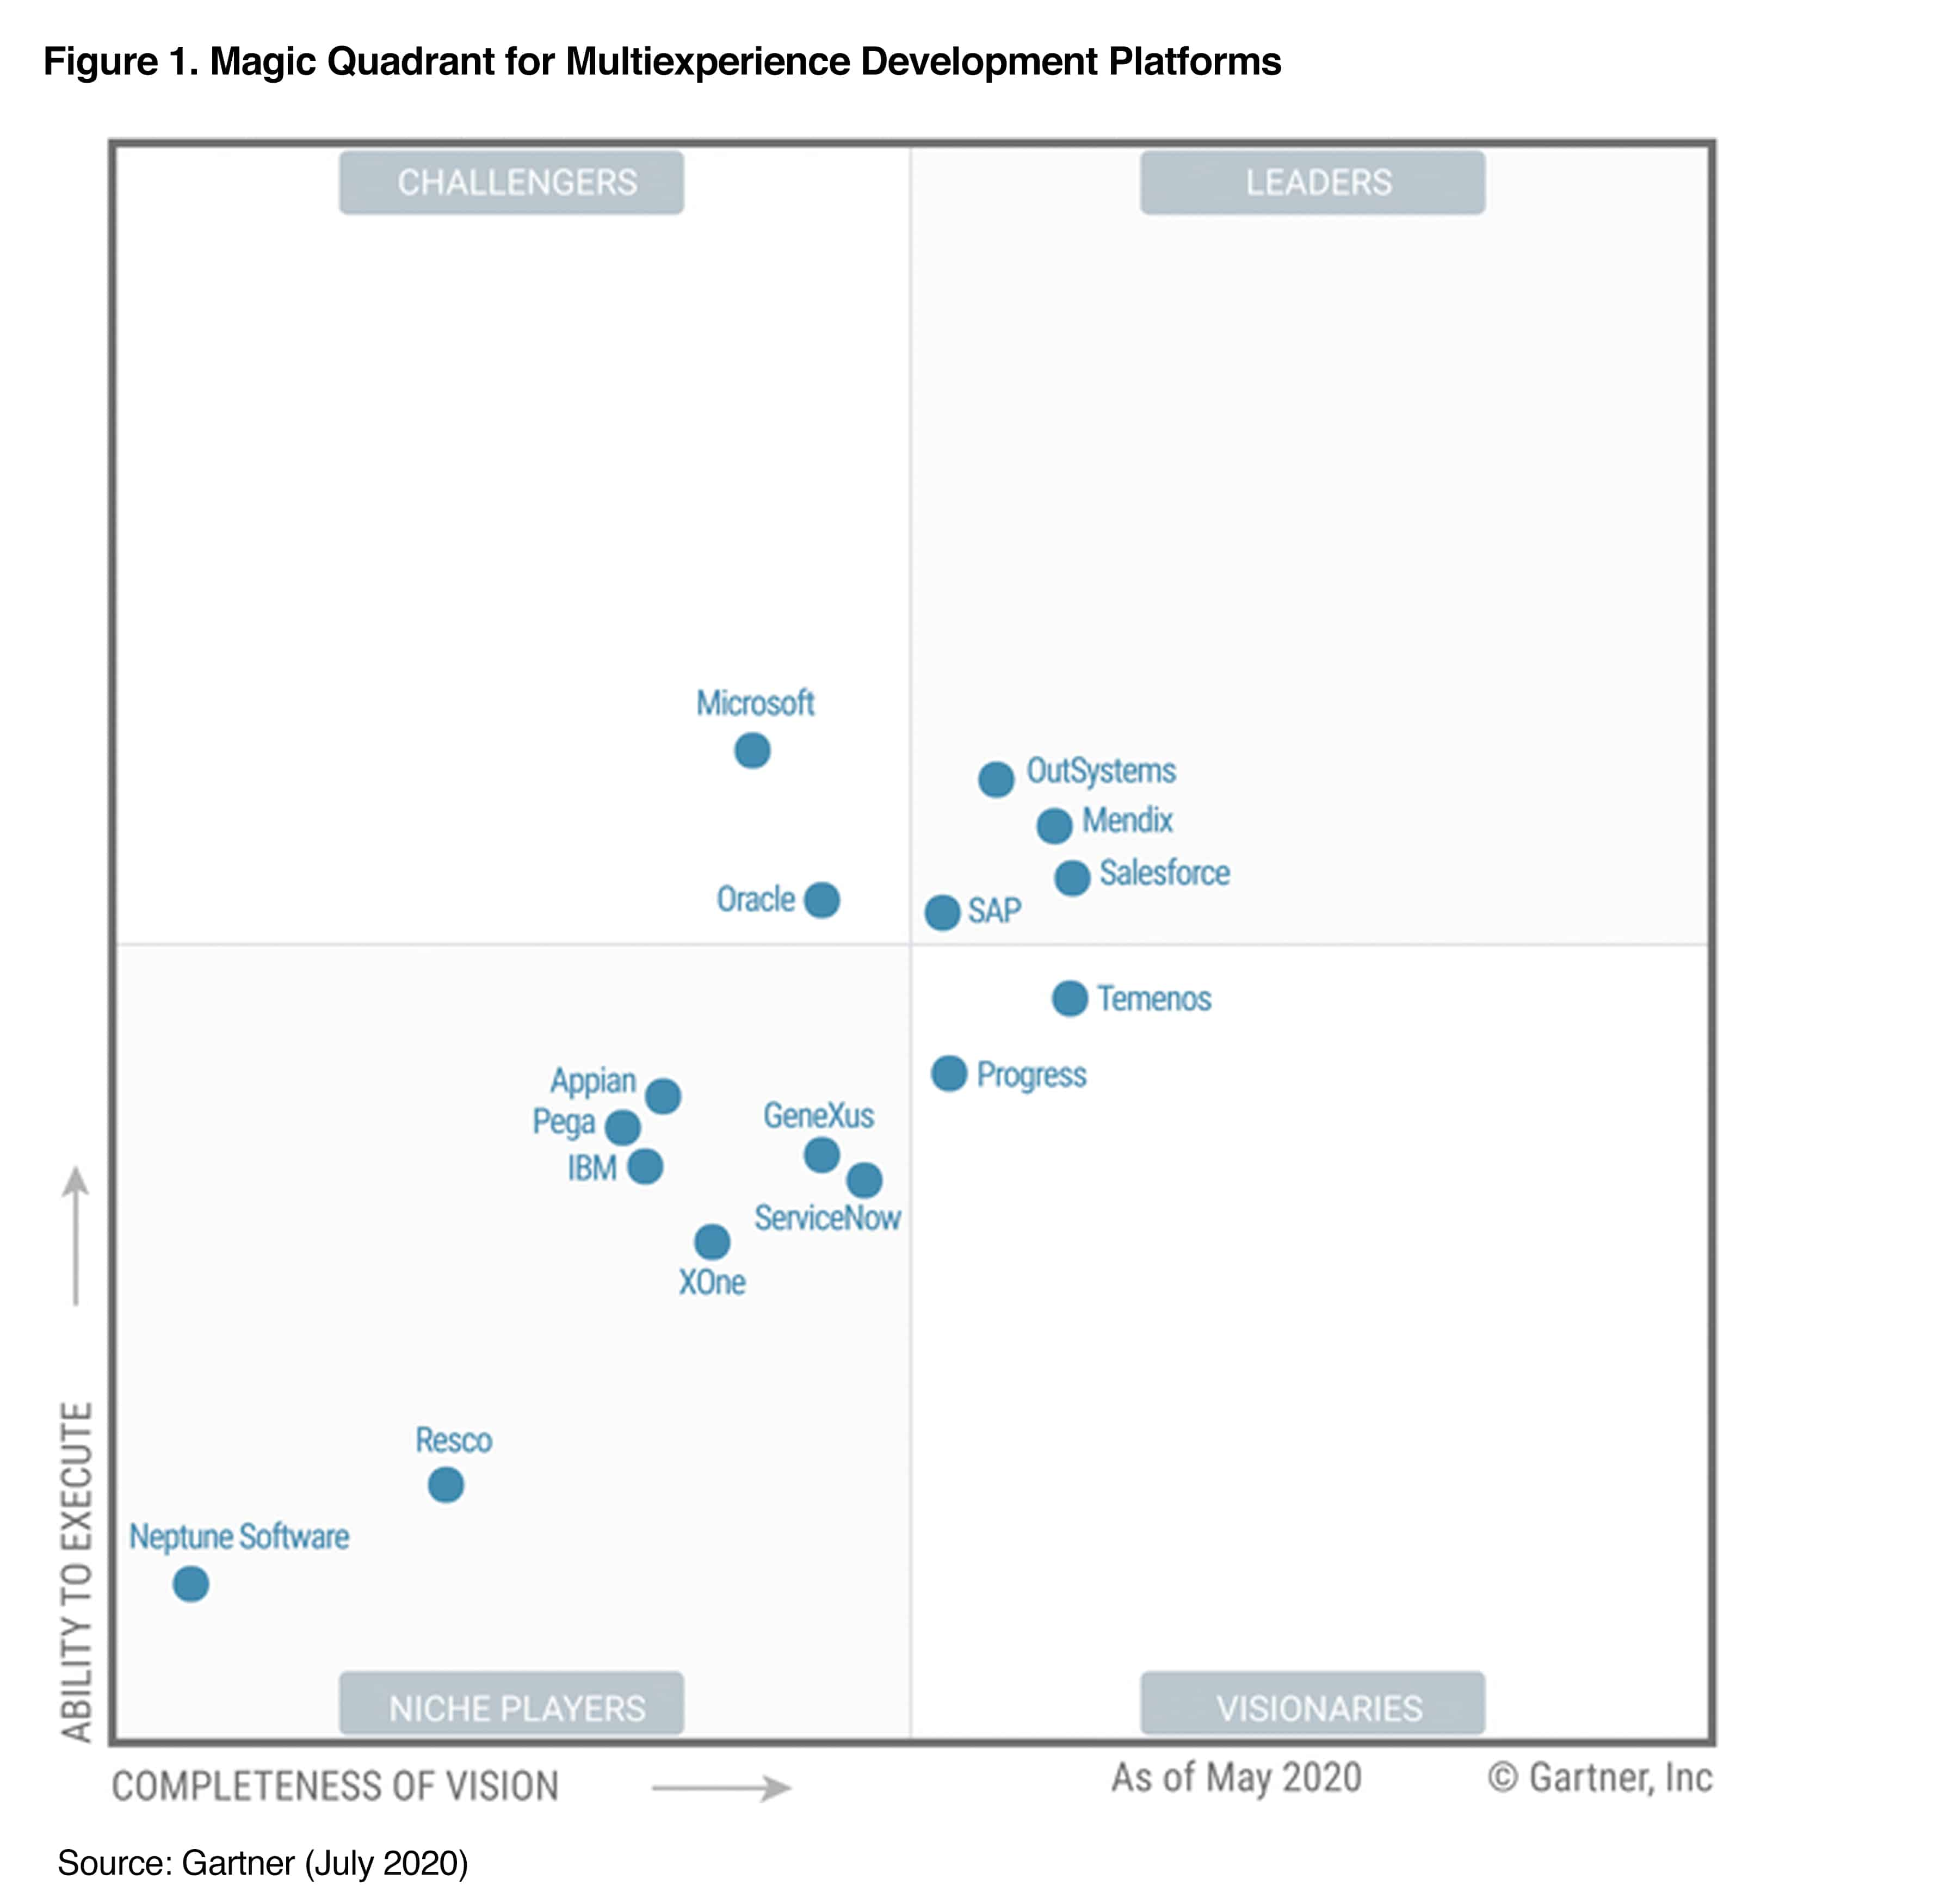
WE ARE one of the key capabilities making SAP a leader is the Gartner 2020 MQ for Multiexperience Development Platforms
SAP Conversational AI facilitates multiexperience development by providing
low-code development tools, enabling companies to revolutionize user experiences with chatbots.
Get the free Gartner report >
Notes:
Insurance, order tracking, routing, premium account, etc!

Slide 16



With conversational interfaces in their workflows, your employees are
More productive
More committed
In a innovative company
Notes:
Insurance, order tracking, routing, premium account, etc!

Slide 17


Here a few examples!
Notes:
Insurance, order tracking, routing, premium account, etc!

Slide 18
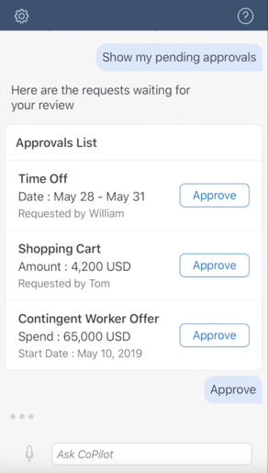
Understanding SAP SuccessFactors’ bot
Challenge
The average SuccessFactors user does not execute HR tasks as a primary function and do not use the solution every day. Because the solution is so rich, sometimes people forget how to do things!
Solution
Provide a conversational interface (chatbot) that can help complete simple HR tasks, answer HR knowledge-based questions and navigate the user to the correct spot within SuccessFactors
Goal
The digital assistant ultimately leads to an improved employee engagement score, a reduction in HR admin time spent answering questions, and a better user experience.
Notes:
Insurance, order tracking, routing, premium account, etc!

Slide 19
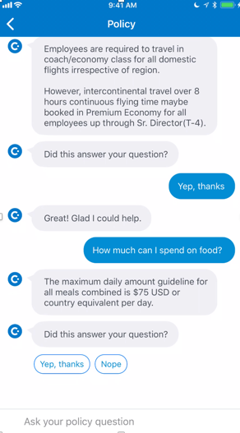
Understanding SAP Concur’s bot
Challenge
Travel policy is often tough to understand and difficult to find, leaving business travelers confused and sometimes “out of compliance”.
To provide greater clarity, travel admins spend countless hours answering questions, and we need to optimize that.
SOLUTION
Provide a Concur Policy bot that helps users get answers about SAP travel policies through an efficient and easy interface.
OUTCOME
By providing critical information to end users, the policy bot will reduce compliance errors resulting in reduced company spend and greater employee satisfaction. The bot will also reduce the workload of travel admins, allowing them to focus on topics with higher value.
Notes:
Insurance, order tracking, routing, premium account, etc!

Slide 20


To sum up:
Leverage conversational interfaces from each SAP solutions
Simplify the experience with one unique SAP Digital Assistant
Customize SAP chatbots and build your own now
Change the work life of your employees
and become the ultimate intelligent enterprise
Notes:
Insurance, order tracking, routing, premium account, etc!

Slide 21

Customer experience
Augment productivity, customer retention and revenue

Slide 22


Your customers expect THE BEST SUPPORT
and instant reaction from your brand
Notes:
Insurance, order tracking, routing, premium account, etc!

Slide 23



Because the number of customer requests increases drastically, customer support services are maxed out
72% of consumers see having to explain their problem to multiple people as poor customer service - GMinder
67% of customers hang up the phone in frustration when they cannot reach a customer service representative - Nextiva
Notes:
Sources: https://www.qminder.com/customer-service-statistics/
https://www.nextiva.com/blog/customer-service-statistics.html

Slide 24

If you don’t scale up your support service, you’ll lose valuable business
Bad customer support amounts to $1,6tr business annual losses due to poor customer service in the US - Accenture
Notes:
SESSION 2 DETAILS
20 mins
Interactive session
“Integrating chatbots in your customer support processes: a fast-paced project”
PE and Omer
1) Introduction to bots : definition, why they matter, why you should get one - 3 mins - PE
Purpose: set the scene and create urgency
2) List of bot building tips and tricks : concentric circles slides + UX tips + channel tips + etc - 7 mins - PE
Purpose: inform and educate to give a sense of specialness
3) Explanation of the 3 step bot building process (slide en escalier) - 8 mins - Omer
Purpose: demystify and encourage bot building
8) CTA
7) Thanks and Q&A

Slide 25

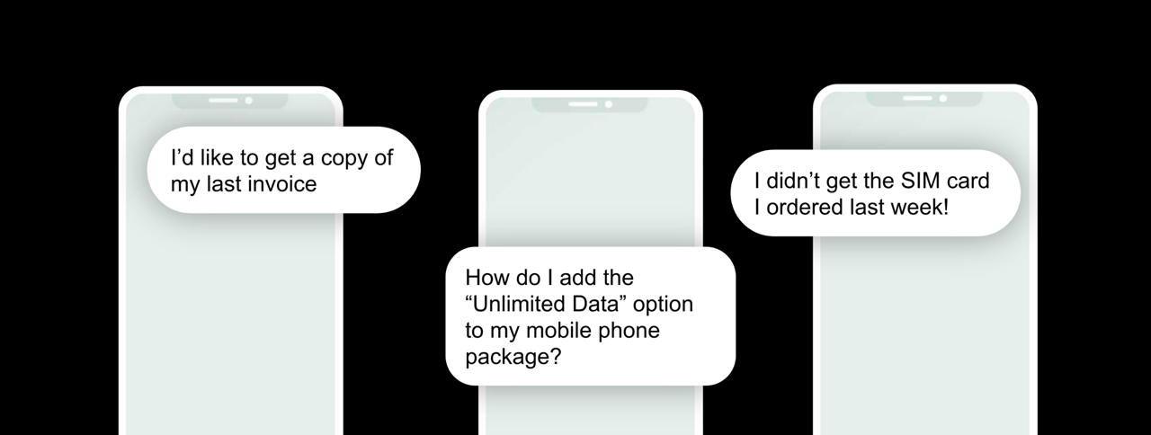
Scaling with human agents is not feasible, but scaling with chatbots is!
I’d like to get a copy of
my last invoice
I didn’t get the SIM card I ordered last week
How do I add the « unlimited data » option to my phone?
Notes:
SESSION 2 DETAILS
20 mins
Interactive session
“Integrating chatbots in your customer support processes: a fast-paced project”
PE and Omer
1) Introduction to bots : definition, why they matter, why you should get one - 3 mins - PE
Purpose: set the scene and create urgency
2) List of bot building tips and tricks : concentric circles slides + UX tips + channel tips + etc - 7 mins - PE
Purpose: inform and educate to give a sense of specialness
3) Explanation of the 3 step bot building process (slide en escalier) - 8 mins - Omer
Purpose: demystify and encourage bot building
8) CTA
7) Thanks and Q&A

Slide 26
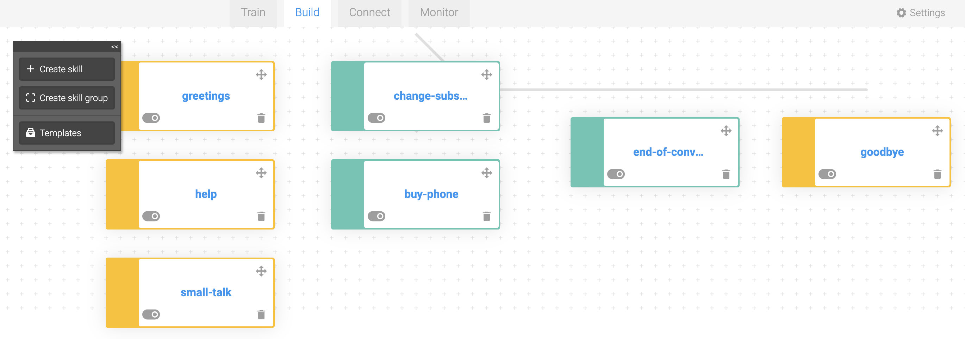
We provide a powerful bot building platform to make chatbot building easy
Our Bot Building platform allows you to train, build, connect and monitor powerful chatbots in one single SAP tool.
See full product demo >

Slide 27




SAP CONVERSATIONAL IS AN END-TO-END BOT BUILDING PLATFORM
TRAIN
BUILD
CONNECT
MONITOR
Train your bot with intents to understand human language.
Build complex conversations, skills, and powerful logic.
Connect your bot to multiple messaging or fallback channels.
Monitor through logs and usage analytics to improve your bot.

Slide 28
WHY US? SAP NATIVENESS!
Native low-code connections
SAP Conversational AI is native to the SAP ecosystem and can be easily connected to other SAP solutions
Notes:
Insurance, order tracking, routing, premium account, etc!

Slide 29




150+ customers have improved employee and customer experiences with chatbots
Telecommunications chatbot
To provide 24x7 instant support while reducing the support desk workload
Insurance chatbot
To automate tedious processes and provide answers to product-related questions
Luxury retail chatbot
To guide customers through the different products and FAQs to generate more online sales
IT chatbot
To answer FAQs from customers, partners, and employees across 10 lines of businesses
HR chatbot
To transform the user navigation and improve efficiency and productivity of employees
Procurement and finance chatbots
To redirect users to the right page and quickly execute low-value tasks

Slide 30
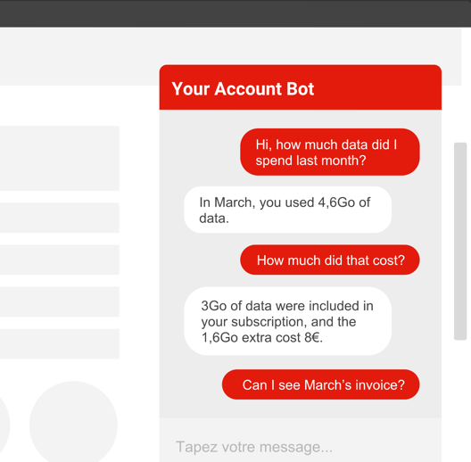




Do not send to customers
Understanding RED by SFR
Leading telecommunication company in France – €14bn revenue in 2017 – 7000 employees
Challenge
OutcomeS
Increasing number of demands to handle, overpowering an already maxed-out customer support service.
Conversation duration is reduced by half because clients have direct access to all relevant information.
90% SFR customers are talking to the correct agent the 1st time
Solution
Automate customer service with a chatbot to provide instant 24/7 support while reducing the support desk workload.
22% Conversations are fully managed by the bot
See demo >
Notes:
Insurance, order tracking, routing, premium account, etc!

Slide 31
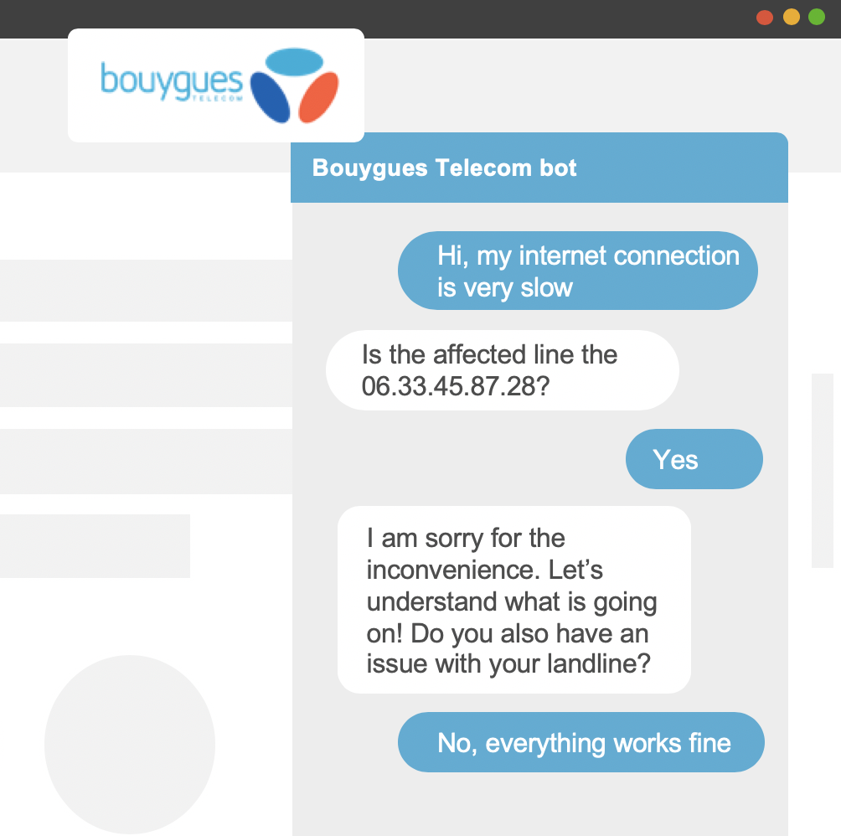
Do not send to customers
Understanding BOUYGUES TELECOM
Leading telecommunication company in France – €5bn revenue in 2017 – 8000 employees
Challenge
OutcomeS
Treating the increasing number of customer requests while improving customer experience.
The conversation duration has been reduced by 15%.
Solution
30% of all customer questions are automated.
Integrate a chatbot on the web site and the mobile app to manage simple issues on internet and mobile subscriptions.
15% of “aborted by user” conversations to 0%,
gaining time and money.
See demo >
Notes:
Insurance, order tracking, routing, premium account, etc!

Slide 32
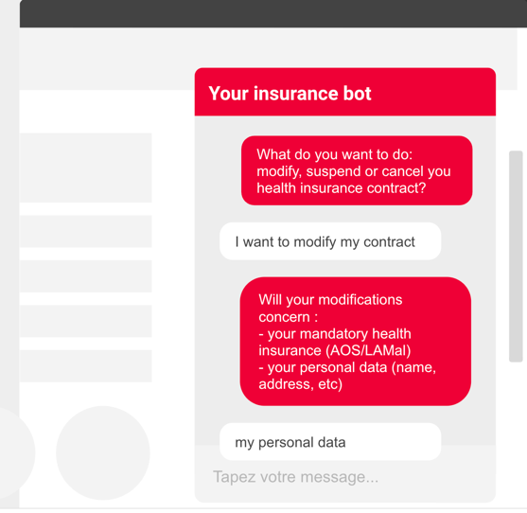
Do not send to customers
Understanding GROUPE MUTUEL
Leading insurance in Switzerland – €308 millions revenue in 2018 – 2,260 employees
Challenge
OutcomeS
Reduce the number of calls to the client’s call center while still providing outstanding support.
75% of questions can be answered right away.
The team now manages the 2 months of rush of the year with 100 people and the bot, instead of 400 people without it.
Solution
Automate the process of modifying, cancelling or suspending insurance contracts with a chatbot.
See demo >
Customer story >
Notes:
Insurance, order tracking, routing, premium account, etc!

Slide 33




Why you need SAP Conversational AI
Common use cases for customers and employees
Customer service
  Sales / Aftersales
Employee service
IT, HR, Analytics
SAP's
Digital Assistant
Pre-select or fully handle repetitive customer support inquiries through a chatbot
Checking of order or invoice request of internal or external users from a back-end; field services through CRM integration
Build your own chatbot - Answer employee inquiries e.g. in IT for password reset or HR for KPIs
Digital Assistant* with OData Services integration, a master hub with pre-built skills* for SAP systems, e.g. HR leave request in SFSF
*will be available soon

Slide 34

In a few words:
By building chatbots with our bot building platform, you are augmenting your productivity, your customer retention, therefore your revenue, and are becoming the intelligent enterprise.
Notes:
Insurance, order tracking, routing, premium account, etc!

Slide 35


Want to get started with SAP Conversational AI?
First steps
Create your account
Tutorial: Build your first chatbot
Read our product documentation
Explore our learning journey
Customer stories
Stay in touch and learn
SAP Community
Tutorials
Blogs
Q&A
LinkedIn + Twitter
YouTube
Roadmap
Start with a productive usage
Get to your Account Executive to subscribe to
SAP Conversational AI
on SAP Cloud Platform through CPEA credits or buy a standalone license on the SAP Store.

Slide 36

Thank you.
Questions? Send your email directly to:
Sebastien Beghelli: sebastien.beghelli@sap.com
Solution Owner - SAP Conversational AI
Karsten Schmidt: karsten.schmidt01@sap.com
Head of SAP Conversational AI

Slide 38



This is how we size and sell new projects
internal
SAP Conversational AI is a cloud-based platform to develop, deploy and monitor Conversational AI applications.
Sales cycle
Deal size
Pricing
Timeline
Sales cycles of around 12 weeks with
upsell potential within a short period.
Always sell with a project to ensure adoption!
Contact
LoB Heads
Internal IT Heads
Innovation Heads and Transformation Heads
Customer Support and Shared Service Centers
Sales bag
SAP Conversational AI is included in the Platform and Technology Salesbag.
SF, C/4 and S/4 for respective Intelligent Technology package (next slide)
Global target
Use cases:
Employee Self-Service
Customer Support automation
Industries
All!
Customer Support: Focus Telco, Insurance, Utilities
Minimum Starting Deal size
50k ACV cloud + 50k services, up to 1.2m TCV
Argue pricing by ROI
Cross sales
SAP Cloud Platform
SAP Conversational AI is cloud-based.
The pricing is based on chats.
A chat is an exchange between a unique user and bot. It ends after 15 mins of user inactivity.
We sell blocks of 1,000 chats.
Material number for subscription is 8006013.
CAI is also available via CPEA, material number is 8007905.
CAI DBS Implementation Service Number is
50145349.
Available via the Intelligent Technology Packages (next slide).
Notes:
Question: what & how can we sell it?
Answer:
use cases and industries: currently, our main focus is customer service: it is the most rewarding use case. Because corporations are facing such big volumes of customer requests, automating certain topics of support are highly beneficial for them at the lowest cost.
Other use cases that performed quite well are the automation of employee self-service applications and e-commerce.
We focus on applying those use cases in the following industries: banking, insurance, telecommunications, utilities, retail and consumer goods
Pricing: The pricing is based on chats. A chat is an exchange between a unique user and bot. It ends after 15 mins of user non-activity. We sell packs of 1000 chats.
Question: how quickly is this solution to realize?
Answer:
Bot methodology: building a chat bot is a simple process and realizable in as little as 12 weeks.
Design: kickoff the project, scope and schedule the collaboration. Hold workshops to define the business objectives, use case and technical requirements.
Create: bot creation and integration, including extensive training and testing sessions
Deploy: execute UATs with customer to validate delivery, test with beta-testers to validate user experience and accompany client from go-live to Business As Usual

Slide 39

Intelligent Technology Packages Material Codes
internal
Intelligent Technology Packages | metric | silver option |  | gold option
 |  | price | material code | price | material code
Intelligent technologies package for SAP SuccessFactors solutions | % of recurring fee | 15% | 8007778 | 30% | 8007790
Intelligent technologies package for SAP C/4HANA | % of recurring fee | 15% | 8007791 | 30% | 8007792
Intelligent technologies package for SAP S/4 HANA Cloud | % of recurring fee | 15% | 8007793 | 30% | 8007794
Intelligent technologies package for SAP S/4HANA [on-premise] | flat fee, per year | 80,000 EUR | 8007821 | 160,000 EUR | 8007822

Slide 40
Pricing (standalone SKU)
Pricing metric is chats, in tiers of 1.000 chats.
A conversation is an exchange between a user and a bot that ends when the user is being inactive for more than 15 minutes.
Tiers 1-10
Block of 1000 chats
Tiers 11-30
Block of 1000 chats
Tiers 31-70
Block of 1000 chats
Tiers 71-100
Block of 1000 chats
Tiers 101-∞
Block of 1000 chats
300€ / month
260€ / month
245€ / month
235€ / month
230€ / month

Slide 41



Project methodology
Design
Development
Test
Production
Workshop 1: Definition of business objectives and ROI
Workshop 2: Platform training
Workshop 3: Conversation flow design
Workshop 4: UAT definition and joint communication actions
Workshop 5: Technical requirements
Bot building in SAP Conversational AI’s back office in two steps:
Technical design
Implementation
Test sessions: with a group of
pre-selected testers
Train sessions: with a group of pre-selected trainers
Execute UATs with customer to validate delivery
Test with beta-testers (end users) to validate user experience and enrich train
Workshop 6: Knowledge transfer with clients’ technical teams
Accompany client from go-live to Business As Usual
Daily monitoring during 2-3 weeks
Suggested: 1 weekly call + 1 monthly steering committee with sponsor

Slide 42

















SAP Conversational AI - Partners

Slide 43



Our main competitors
internal
Bot Building Platform
Digital Assistant
d
Targeted at developer:
  Doesn’t feature strong collaboration tools
  Doesn’t provide CRM integrations for human fallback
No direct competition to SAP, but similar offerings primarily in the consumer space, Amazon and Google entering the enterprise space
Few pre-trained packs to fasten bot building
Poor developer experience because of complex interface
IBM Watson
Very long time to market
Complex interface, hard to use
Long projects because ML is not always leveraged (entities)
Amazon Alexa
Microsoft Cortana
d
Only supports English
Long projects because ML is not always leveraged (entities)
Very few B2B references
Poor developer experience because of complex interface
Long project times
Apple Siri
Google Assistant

Slide 44










SAP Enterprise Support – The foundation for continuous customer success
Collaboration
Empowerment
Innovation and
value realization
Mission-critical support
Proactive
and preventive
support
Across all deployment options
SAP Enterprise Support
The foundation for customer success
Seamless consumption of innovation I Fast value realization I Business outcomes I End-to-end optimization
Intelligent enterprise
External Slide; internal note: Competition charges EXTRA for support!
Cloud
Digital core
Breakthrough innovations
Notes:
SAP Enterprise Support is the foundation support for customer success. Proactively control mission critical processes, simplify hybrid landscapes, and drive innovation and business outcomes with SAP Enterprise Support, empowered by support experts worldwide and by modern Next-Generation Support collaboration.
At the core of SAP solutions in cloud and on-premise for a seamless end-to-end customer support experience based on SAPs ONE Support approach, SAP Enterprise Support includes powerful services, tools and expertise to ensure business continuity and maximize value realization.
It consists of 4 key pillars, including collaboration, empowerment, innovation and value realization, and mission-critical control. With the eventual goal of helping customers become intelligent enterprises in their digital transformation, SAP Enterprise Support provides proactive and preventive support for customers to move to the cloud, move in the cloud, make SAP S/4HANA digital core, and deploy breakthrough innovations across all deployment options.

Slide 45
Build you own chatbot & learn more
Sign up and build your own prototype here.
Get in touch with us to discuss your use case.
Inform | SAP Conversational AI on sap.com SAP Documentation Help Portal with New Release Update Announcements How to integrate into SAP Customer Engagement Center Whitepaper on CAI Business Case
Learn | NodeJS chatbot tutorial Tutorials
Buy | Contact your SAP Account Executive Consume via SAP Cloud Platform Enterprise Agreement Buy via SAP Digital Store
Contact | Twitter @SAPCAI E-Mail businesscai@sap.com
Notes:
An organization in the CAI platform, it enables team members to collaborate on the bots they create, and share with others within the organization they’re part of. Send Boris Andree or Ed Fronc Profile name once account created.

Slide 46
Build you own bot & learn more – additional internal links
internal
Slack for CAI | Join the internal Slack Channel
JAM Site | Latest material on JAM
Official SAP Reference Customers | Find the list and assets here
Roadmap | External roadmap is here
Notes:
An organization in the CAI platform, it enables team members to collaborate on the bots they create, and share with others within the organization they’re part of. Send Boris Andree or Ed Fronc Profile name once account created.

Slide 47
Demos
internal
Product demo
Bot Building Platform demo >
Customer demos
RED by SFR live bot demo >
Bouygues Telecom live bot demo >
Groupe Mutuel live demo >
Digital Assistant live demo >
Feature demo
FAQ Bot Generator >
Chat histories Bot Generator >
SAP Bot Generator (Odata) >
Notes:
Insurance, order tracking, routing, premium account, etc!

