Slide 1
SAP Data Intelligence Turn data chaos into business value
Speaker’s Name, SAP
Month 00, 2021

Slide 2
Disclaimer
The information in this presentation is confidential and proprietary to SAP and may not be disclosed without the permission of SAP. Except for your obligation to protect confidential information, this presentation is not subject to your license agreement or any other service or subscription agreement with SAP. SAP has no obligation to pursue any course of business outlined in this presentation or any related document, or to develop or release any functionality mentioned therein.
This presentation, or any related document and SAP's strategy and possible future developments, products and or platforms directions and functionality are all subject to change and may be changed by SAP at any time for any reason without notice. The information in this presentation is not a commitment, promise or legal obligation to deliver any material, code or functionality. This presentation is provided without a warranty of any kind, either express or implied, including but not limited to, the implied warranties of merchantability, fitness for a particular purpose, or non-infringement. This presentation is for informational purposes and may not be incorporated into a contract. SAP assumes no responsibility for errors or omissions in this presentation, except if such damages were caused by SAP’s intentional or gross negligence.
All forward-looking statements are subject to various risks and uncertainties that could cause actual results to differ materially from expectations. Readers are cautioned not to place undue reliance on these forward-looking statements, which speak only as of their dates, and they should not be relied upon in making purchasing decisions.

Slide 3
Agenda
SAP Data Intelligence Overview
Core capabilities of SAP Data Intelligence
Data Integration
Data Processing
Data Catalog
Key value-add scenarios for SAP customers
SAP integration
Data Management for SAP BTP
Hybrid Data Management
Deployment & Connectivity
Reference customers
Wrap up

Slide 4
Agenda
SAP Data Intelligence Overview
Core capabilities of SAP Data Intelligence
Data Integration
Data Processing
Data Catalog
Key value-add scenarios for SAP customers
SAP integration
Data Management for SAP BTP
Hybrid Data Management
Deployment & Connectivity
Reference customers
Wrap up

Slide 5
SAP Data Intelligence Overview

Slide 6
The Data-Driven Journey Towards the Intelligent Enterprise
Business Processes
Data Integration
Operationalization
Data
Insights
Data Processing
Notes:
Data is trivial without intelligence, and intelligence is pointless without action. We need to be able to extract intelligence insights from disparate data, and then operationalize those insights within business processes, which will therefore produce even more fine grained data to feed a virtuous circle.

Slide 7
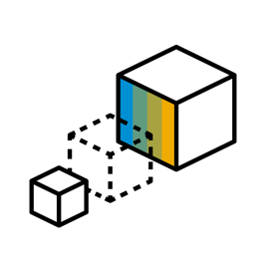
But most enterprises get stuck in the journey!
71%
53%
82%
Struggle to connect big data to enterprise data and business processes¹
Enterprises are not yet treating data as a business asset²
Recognize that orchestrating data and processes is critical¹
¹ Forrester Consulting, 2019 Hybrid Data Management Drives Innovation and Growth
² NewVantage Partners’ 2019 Big Data and AI Executive Survey

Slide 8
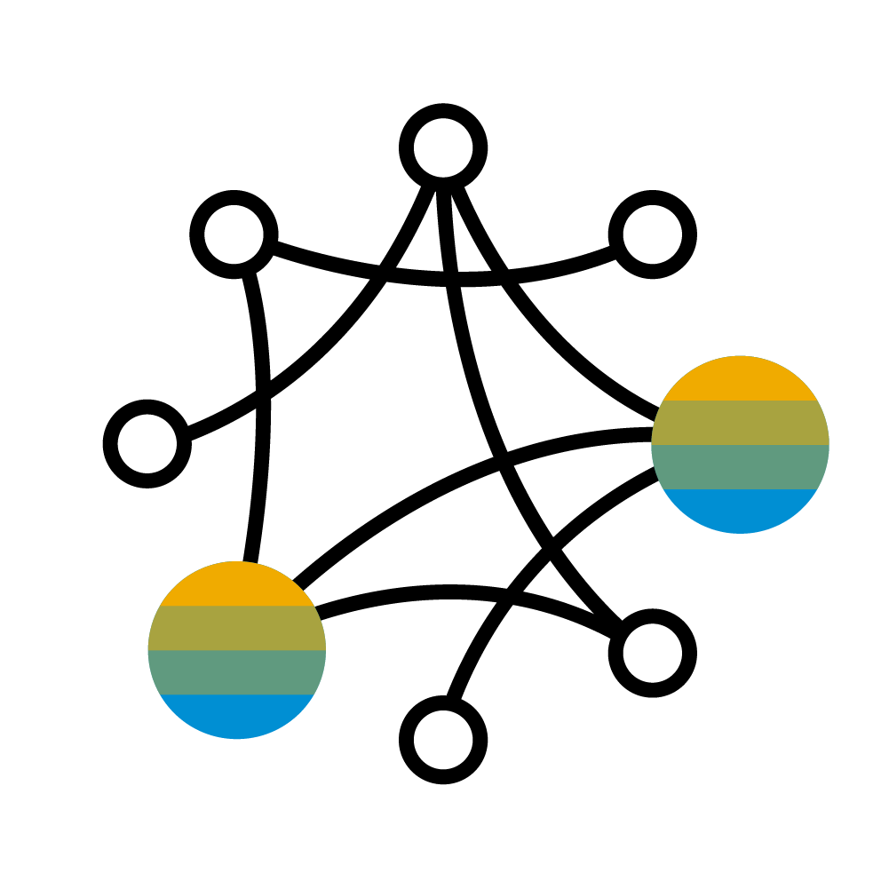
Why is Data Management so difficult?
Data cataloging
Data Quality
Non-SAP Applications
Data ingestion
ELT
Data masking
Machine Learning
Streaming Analytics
SAP Applications
Cloud Data Lakes
Event Stream processing
Video Processing
Data replication
3rd party databases
Data cleansing
Image Processing
ETL
Data profiling
Graph processing
Time series
Speech Recognition
3rd party Data Warehouses
Semi-structured and unstructured data
Meta Data management
Text analytics
Geospatial Processing

Slide 9
Why is Data Management so difficult? Enterprise IT is challenged to a whole new degree!
Integration
Processing
Discovery
“I need to join my sensor data with some image bitmap and with the related master data”
“I’m clustering the data in Python to feed a predictive model in HANA”
“What is this data and what does it mean?”
Quality
Compliance
Operations
“Can I rely on this data to drive decisions in a critical process? How was it gathered?”
“Where am I storing personal identity information of German citizens?”
“My data and engines are spread between my on premise data centre and my hyperscaler cloud”

Slide 10
Why is Data Management so difficult? Enterprise IT is challenged to a whole new degree!
Integration
Processing
Discovery
Structured, unstructured, streaming
Batch, (near) real-time
Transactional, Analytical, Hybrid
Several heterogeneous engines
Diverse processing patterns (offline, lambda, event-driven …)
Discover the available data sets, and find out their semantics
Quality
Compliance
Operations
Data inconsistencies and fragmentation
Biased data sets
ML model life cycle
Data privacy and protection
Data lineage and auditing
Distributed landscapes, cloud and on-prem
Elastic scaling
Monitoring
Notes:
There is a new domain…what are the main issues…
Goes into detail of additional or new requirements of the data management layer when you introduce ML
(relevant to traditional BI teams…)
Most ML teams may have seen these before, but not in this systematic POV
Integration: 3 different kinds of data and integration
Processing: need different processing engine (eg, Tensorflow, Python or Spark) which all different requirements for each (eg, Offline, event driven, etc)
Discovery: to develop an effective application need to know the meaning of the data (ie, metadata catalogs, self service, profiling etc)
Quality: additional DQ added ; ie, managing training data sets vs run-time data sets, and detecting biases in data sets (very different than traditional analytics. Now less margin for error and chance to massage, b/c automation does not allow for manual intervention at scale
Compliance: applying policy to unstructured documents in data lakes – tough
Operations: training need more compute and runtime – hence need for containerization(kubernetes and docker)
Bottom line; b/c of the above, you need to apply new kinds of technologies and approaches (new kind of data mngt software) to succeed

Slide 11
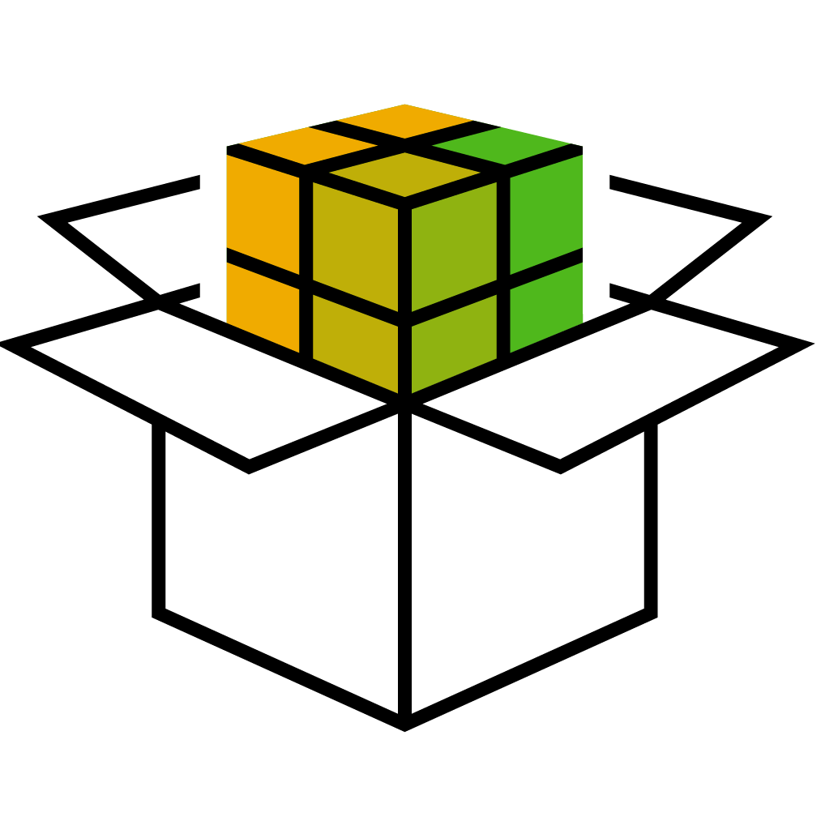
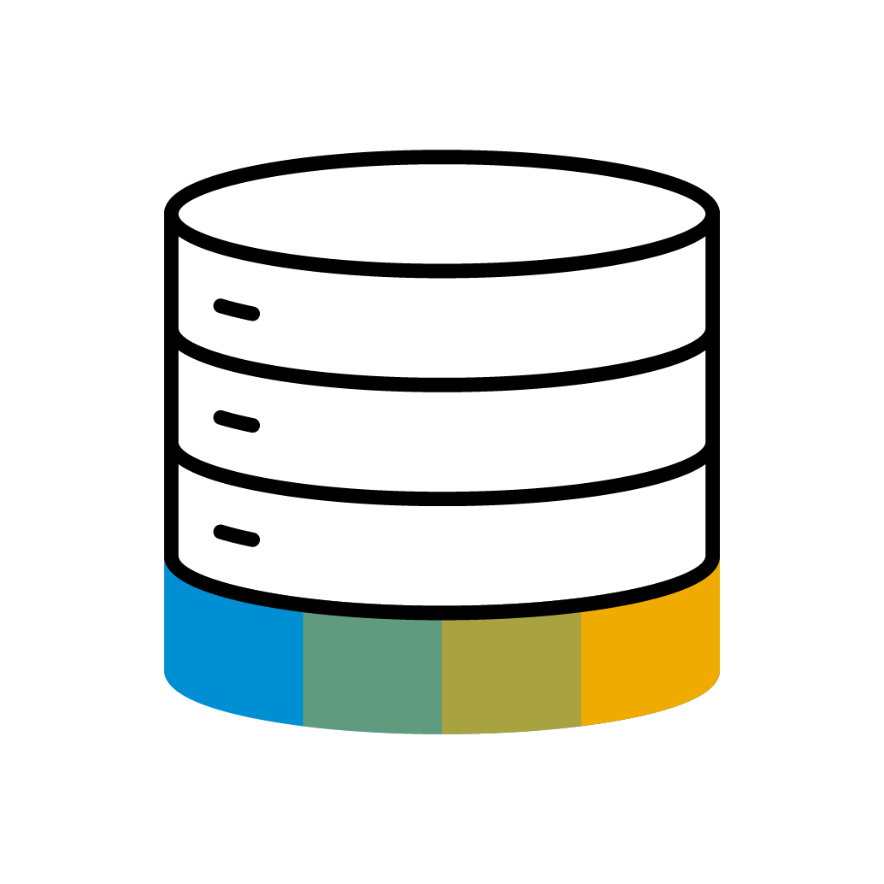
The evolution of Data Management in enterprise landscapes
Data Diversity
Data Orchestration
(HTAP, Big Data, Cloud etc.)
Streaming, IoT, ML, Big Data, Advanced Analytics, Insight 2 Action…
Analytics Integration
ETL, EDW, BI, MIS, Data Marts…
SAP Data Intelligence
Turn disparate data into advanced analytics, and operationalize them within business processes
Application Integration
MFT, EAI, ESB, SOA, B2B, BPM/BRM…
EIM portfolio
SAP LT Replication Server (SLT)
SAP Data Services
Smart Data Integration
…
SAP Integration Suite
Cloud Integration, PO etc.
SAP Data Intelligence
Enterprise Intelligence
Notes:
Natural consequence of evolution and the rise of a new domain
Very different job requirements
---
In the past decades, the evolution of enterprise IT landscapes, of their maturity and of their business contexts and objectives, has always brought along essential demands of data integration, and critical concerns of data governance.
The history of enterprise IT is now at a turning point, where several disruptions are coming together almost simultaneously: the vast adoption of IoT technologies, the rise of Data Science as a common IT practice, the availability of massive data assets and computational power which are now enabling large-scale usage of machine learning, the unprecedented distribution and scaling possibility offered by cloud architectures. What is the impact that this change is having on data integration and data governance?
Despite integration and governance address some functional needs and concerns which are always the same across every context, like data movement, workflow orchestration or metadata management, these needs and concerns must translate and adapt to very different architectures, with different applicability and design focus, depending on the target integration domain.
We can represent the evolution of integration domains in the enterprise through a simple diagram, acting on two axes: the degree of Enterprise Intelligence (i.e., the ability to execute more intelligent business decisions and processes) is growing, fueled by the ability to exploit more diverse and heterogeneous data.
At first, the base for every Enterprise Architecture is to enable transactional applications to talk with each other, in order to connect processes. This is the Application integration domain, which we address with technologies and architecture patterns like SOA, Enterprise Service Buses, BPM and BRM engines, or, in past decades, with older technologies like Managed File Transfer, Enterprise Application Integration etc.
Then, we have to integrate data from transactional processes towards enterprise BI, in order to support business decisions: that is the Analytics integration domain, which we address with technologies like ETLs, EDW, Data Marts etc.
Everybody in Enterprise IT understands the difference between these two domains: nobody would use an ETL to connect two transactional applications, or an ESB to feed a Data Warehouse.
Now, what IT organizations are facing at this time of their history is, by all means, the breakthrough of a brand-new integration domain. With the rise of Data Science, Big Data, IoT and Machine Learning we now aim at producing actionable advanced analytical insights that we can use not just to produce BI reports, but also to actually drive and influence more intelligent transactional processes. In other words, OLTP and OLAP are merging into HTAP, new kinds of hybrid data processing are emerging, with no strict distinction between transactional and analytical processing, and with the demand of mixing several different kinds of data sources and processing paradigms, like for example combining image processing and signal processing with structured backend data refining and enrichment.
This is a whole new integration domain, separate from both Analytics Integration and Application Integration. At SAP, we call it Data orchestration, but it is often called also with other synonyms like Big Data Fabric, Data Ops, Holistic Data Management, Data-driven integration etc..

Slide 12
SAP Data Intelligence – From Data Integration to Data Orchestration
Data Processing
Extract meaning and ensure trust in your data
Data Integration
Business Process
Analyze all of your data, not just the 1%
Infuse insights into improved business processes

Slide 13
SAP Data Intelligence – Core Capabilities
SAP Data Intelligence
Data Integration
Data Processing
Data Catalog
Connect and integrate everything, structured, unstructured or streaming
Extract meaning from data, orchestrating any mix of engines
Discover, classify, profile, understand and prepare all your enterprise data assets
Notes:
Pre-built content in SAP BTP allows you to accelerate your time to value.
From over 1,800 ready-to-use integration packs, to cloud extensions tailored for your industry and line of business, and over 100 prebuilt Analytics content package, SAP ensures you drive value fast, and maximize continued innovation.
Some technology platforms take many months of implementation and significant investment in order to achieve any business value.
SAP Business Technology Platform is unique. The platform is comprised of multiple solutions, however, they can be rapidly combined together like Lego for quick time to value. This accelerated payback period fuels subsequent customer use cases. Through rapid value realization our customers achieve success fast.

Slide 14
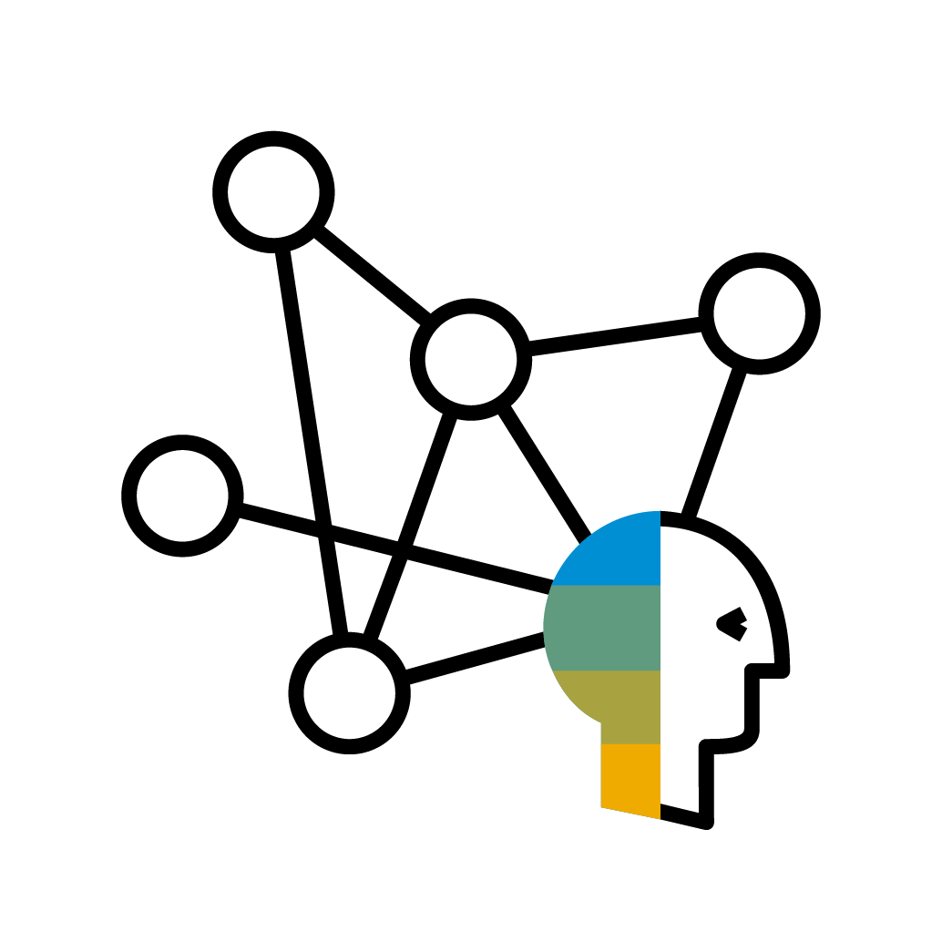
SAP Data Intelligence – Key value-add scenarios for SAP customers
SAP Data Intelligence
SAP Integration
Data Management for SAP BTP
Hybrid Data Management
Connect SAP applications at the ABAP layer, and reuse data semantics for all analytics
Single coherent cloud data management solution for the SAP BTP
Reuse all existing SAP tools and manage the end-to-end landscape
Notes:
SAP Business Technology Platform provides outcomes across 3 main customer scenarios.
Integration – complex IT landscapes include on premise and cloud systems, SaaS applications and hyperscaler technology. Integration is essential to enhance business operations across the entire value chain by connecting all systems seamlessly.
Data to Value – it’s essential that organizations have a consolidated view across all their data assets and are able to achieve insight and make real time decisions, especially during times of rapid change
Extensibility – companies need to stay agile and adapt rapidly to new business conditions and changing customer demands. Extension allows companies to build and enhance all their application investments to meet their customer’s dynamic needs and provide continual value.

Slide 15
Data Intelligence use cases
We included one sample use case in this L2 deck.
A library of alternative use cases, for different industries and LoBs, is available here.

Slide 16
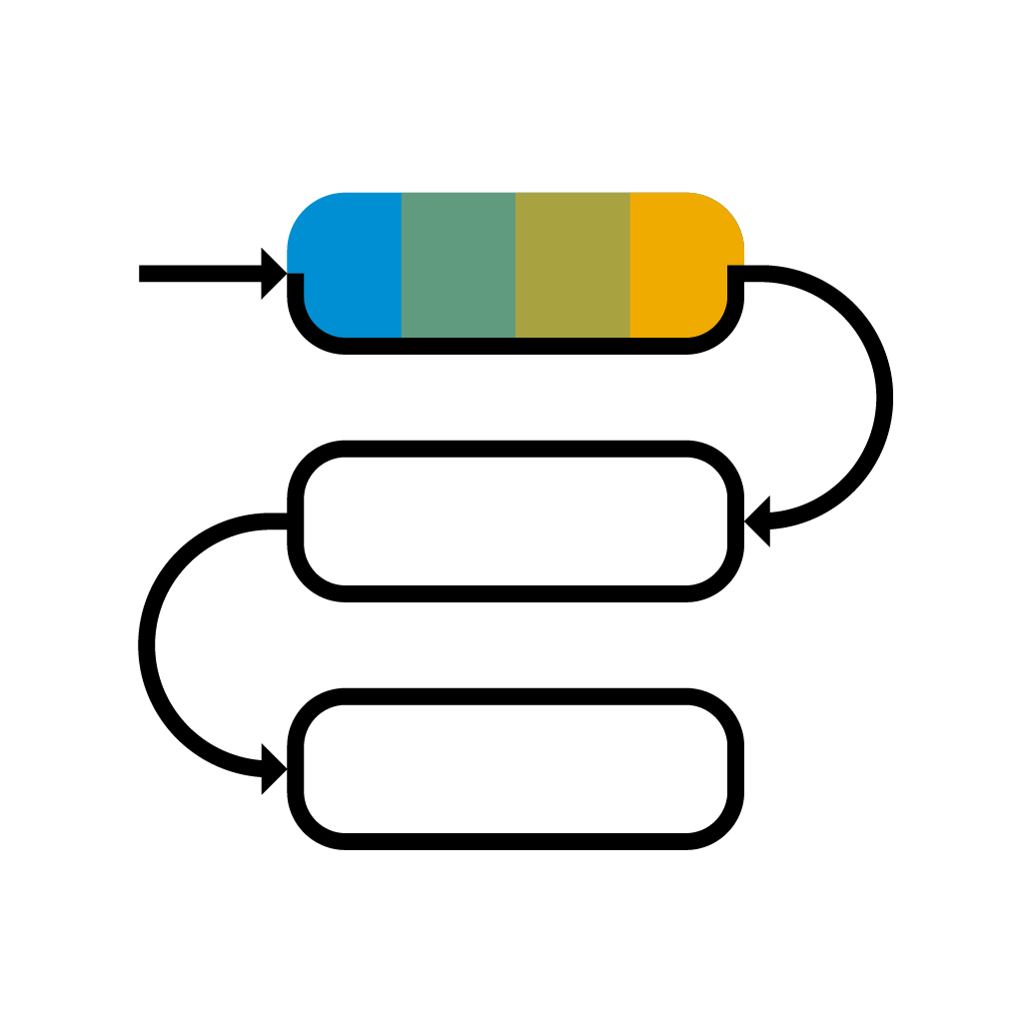
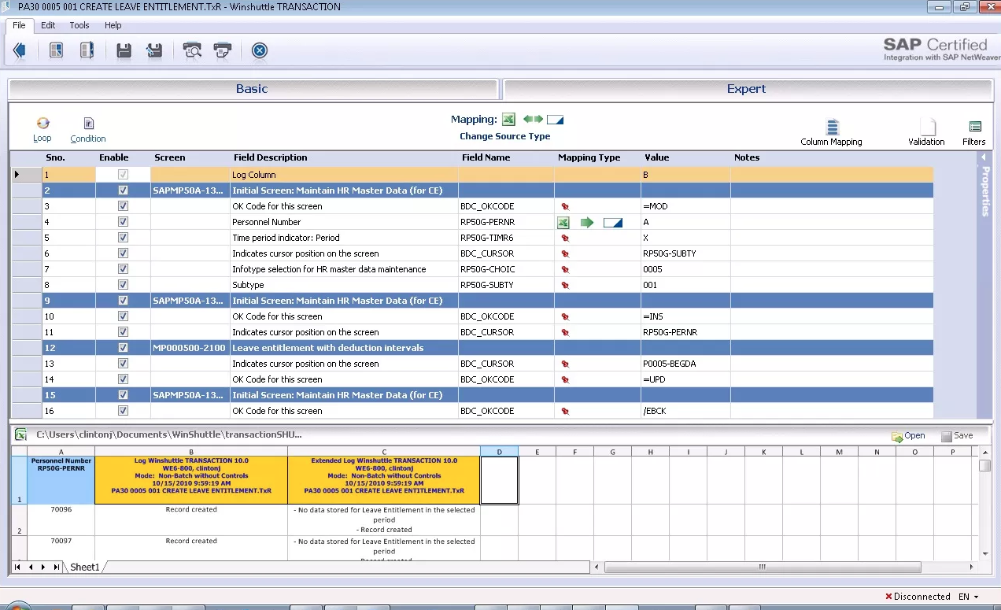
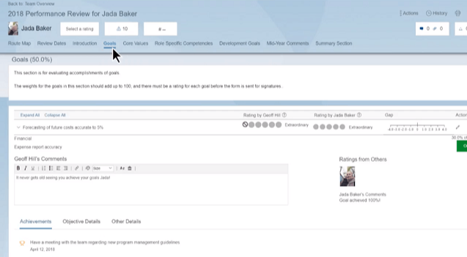
A real-life example: HR Best Fit with SuccessFactors The business objective: find best fits within workforce to cover job postings
Data Integration
Data Processing
Business Process
SAP HR data
SFSF Seniority data
Knowledge Scoring Data
R Best Fit Model
Job posting vs. Employees Score
Location Data
Areas & Knowledge Data

Slide 17
HR Best Fit with SuccessFactors The as-is before Data Intelligence: manual integration and weekly batches
Manual point-to-point integrations
Employee Personal Data & Job Position Data
Weekly updates
Employee Seniority Data
Excel sheet with Best Fitting Employees, refreshed weekly
Data extracts to Excel files
Best Fit
Areas & Knowledge Data
Employee Knowledge Scoring Data
Point-to-point data extract
Notes:
Data Hub allowed us to quickly achieve the objective, through orchestrated pipelines, depicted in yellow in this picture.
On one side, we are getting the business partner data from S/4 HANA Cloud, and executing some pre-processing and masking of that data using a Python engine, in the cloud, close to the data source. Then we have a different pipeline performing sentiment analysis of the Twitter feed, and these data assets are then joined to the data we have from SAP Credit Management and from the Ariba Risk Score. The customer address is validated against our Address check service, and the combined set of enriched data is then used to feed the ML scoring algorithm in a Python engine.
The outcome of the scoring algorithm is then stored in HANA, where we can use it both for improving the operational process in S/4 HANA, and for feeding a SAC dashboard.

Slide 18
HR Best Fit with SuccessFactors The solution with Data Intelligence: streamlined operationalization, real-time insights
Real Time Matching by Job Posting Code
Employee Personal Data & Job Position Data
SAP Data Intelligence
Employee Seniority Data
Best Fitting Employee List related to input job posting
Best Fit
Score Scaling according to Location
Areas & Knowledge Data
Employee Knowledge Scoring Data
Distance Data Employee – job posting location
Data Intelligence pipelines
Notes:
Data Hub allowed us to quickly achieve the objective, through orchestrated pipelines, depicted in yellow in this picture.
On one side, we are getting the business partner data from S/4 HANA Cloud, and executing some pre-processing and masking of that data using a Python engine, in the cloud, close to the data source. Then we have a different pipeline performing sentiment analysis of the Twitter feed, and these data assets are then joined to the data we have from SAP Credit Management and from the Ariba Risk Score. The customer address is validated against our Address check service, and the combined set of enriched data is then used to feed the ML scoring algorithm in a Python engine.
The outcome of the scoring algorithm is then stored in HANA, where we can use it both for improving the operational process in S/4 HANA, and for feeding a SAC dashboard.

Slide 19
Agenda
SAP Data Intelligence Overview
Core capabilities of SAP Data Intelligence
Data Integration
Data Processing
Data Catalog
Key value-add scenarios for SAP customers
SAP integration
Data Management for SAP BTP
Hybrid Data Management
Deployment & Connectivity
Reference customers
Wrap up

Slide 20
SAP Data Intelligence – Core capabilities

Slide 21
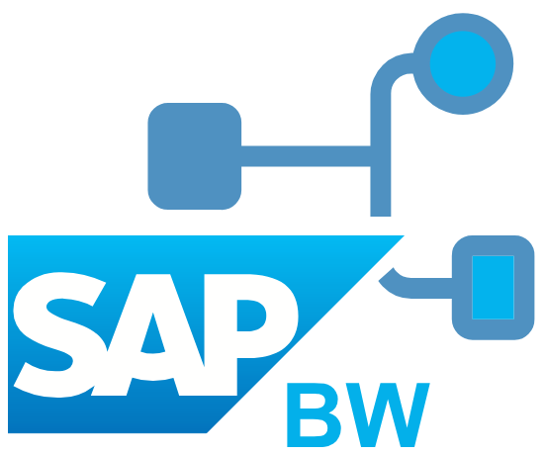
SAP Data Intelligence
SAP Applications
Distributed & External Data Systems
SAP NetWeaver
+ DMIS Addon
ABAP Integration
Standard Connectors (open & native protocols)
SAP S/4HANA®
SAP Data Intelligence
Streaming (e.g. IoT)
SAP S/4HANA® CLOUD
Cloud Storages
SAP BW/4 HANA
SAP BW
BW Integration
Hadoop / HDFS
Cloud Data Integration
Data Integration
Data Ingestion / Data Enrichment / Data Workflows
REST APIs
SAP C/4HANA
Databases
…
Public Clouds
Data Processing
Exploration / Model Design / ML orchestration
3rd Party Connectors
Workflows
3rd Party Applications
BW Process Chains
Data Services Jobs
HANA Flowgraphs
SAP BTP Connectors
SAP API Business Hub
SAP Analytics Cloud
SAC Push API
Data Catalog
Data Discovery / Data Profiling / Metadata Cataloging
SCI for process integration
SAP HANA®
(on-premise, cloud, multi cloud)
SAP HANA Integration
SAP Open Connectors
Notes:
1) Expose the application data
Native integration into ABAP via ABAP Agent & proven technologies like SLT
For SCP-based and independent apps Cloud Data Integration API based on OData
Tight integration with HANA for certain scenarios
2) Provide business semantics via Metadata Management
Crawler enables to browse and discover data
Provide semantics of the data in Metadata Management
For S/4 (partly) automatic enrichment e.g. via DDIC, CDS …
3) Combine & enrich data from various applications & data sources in business scenarios
Cleanse data from your applications and combine & enrich with other data sources
Decide which data should be shared in the distributed datalake
4) Get control of the data processing via Pipelines
Built operators to natively integrate with your application (various languages & also embedded into ABAP)
Build pipelines & operators to do advanced data processing
5) Utilize the enriched data in Analytics Cloud, BW & Machine Learning
Enriched data in business scenarios can be used in analytical scenarios and machine learning scenarios
Direct integration with Analytics Cloud, BW/4 HANA and ML Foundation (later also DSP)
6) If you want to build a data-driven app utilize the full potential of Data Hub as a platform
Use the full potential of the Data Hub system management, Pipelines and the tight integration with SCP

Slide 22
SAP Data Intelligence
SAP Applications
Distributed & External Data Systems
SAP NetWeaver
+ DMIS Addon
ABAP Integration
Standard Connectors (open & native protocols)
SAP S/4HANA®
SAP Data Intelligence
Streaming (e.g. IoT)
SAP S/4HANA® CLOUD
Cloud Storages
SAP BW/4 HANA
SAP BW
BW Integration
Hadoop / HDFS
Cloud Data Integration
Data Integration
Data Ingestion / Data Enrichment / Data Workflows
REST APIs
SAP C/4HANA
Databases
…
Public Clouds
Data Processing
Exploration / Model Design / ML orchestration
3rd Party Connectors
Workflows
3rd Party Applications
BW Process Chains
Data Services Jobs
HANA Flowgraphs
SAP BTP Connectors
SAP API Business Hub
SAP Analytics Cloud
SAC Push API
Data Catalog
Data Discovery / Data Profiling / Metadata Cataloging
SCI for process integration
SAP HANA®
(on-premise, cloud, multi cloud)
SAP HANA Integration
SAP Open Connectors
Notes:
1) Expose the application data
Native integration into ABAP via ABAP Agent & proven technologies like SLT
For SCP-based and independent apps Cloud Data Integration API based on OData
Tight integration with HANA for certain scenarios
2) Provide business semantics via Metadata Management
Crawler enables to browse and discover data
Provide semantics of the data in Metadata Management
For S/4 (partly) automatic enrichment e.g. via DDIC, CDS …
3) Combine & enrich data from various applications & data sources in business scenarios
Cleanse data from your applications and combine & enrich with other data sources
Decide which data should be shared in the distributed datalake
4) Get control of the data processing via Pipelines
Built operators to natively integrate with your application (various languages & also embedded into ABAP)
Build pipelines & operators to do advanced data processing
5) Utilize the enriched data in Analytics Cloud, BW & Machine Learning
Enriched data in business scenarios can be used in analytical scenarios and machine learning scenarios
Direct integration with Analytics Cloud, BW/4 HANA and ML Foundation (later also DSP)
6) If you want to build a data-driven app utilize the full potential of Data Hub as a platform
Use the full potential of the Data Hub system management, Pipelines and the tight integration with SCP

Slide 23
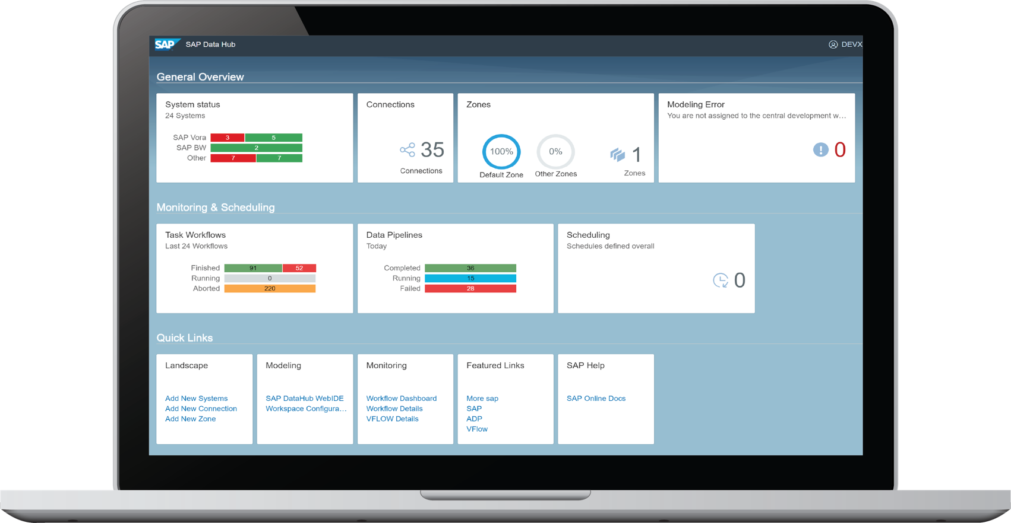
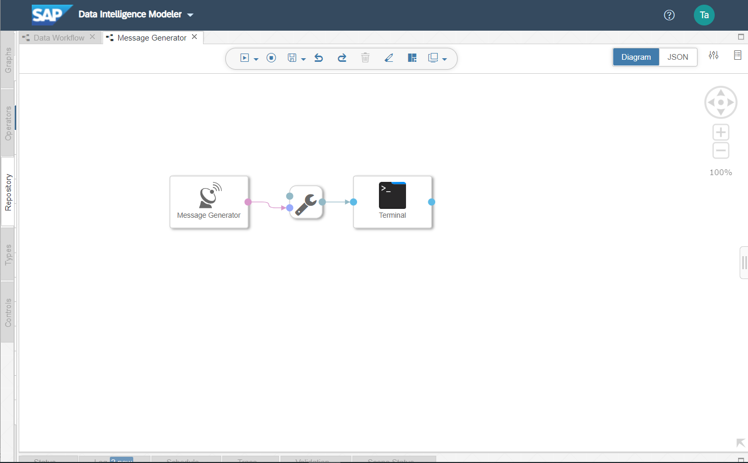
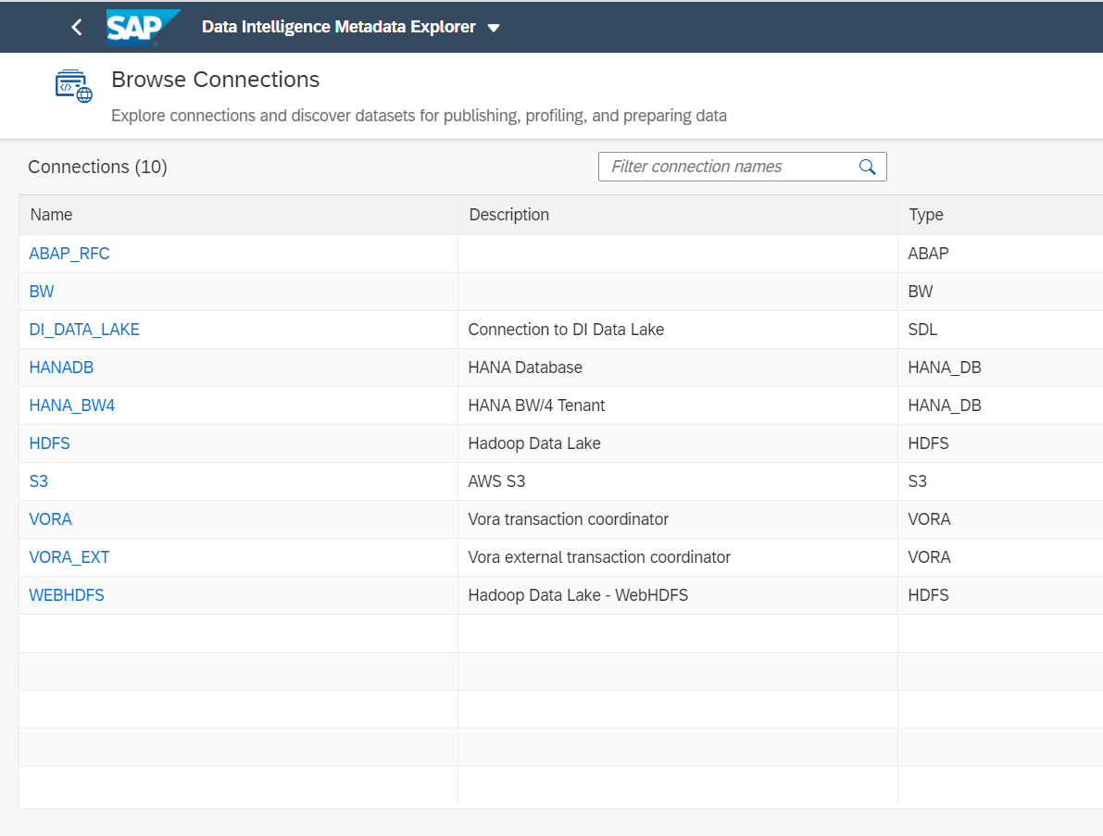
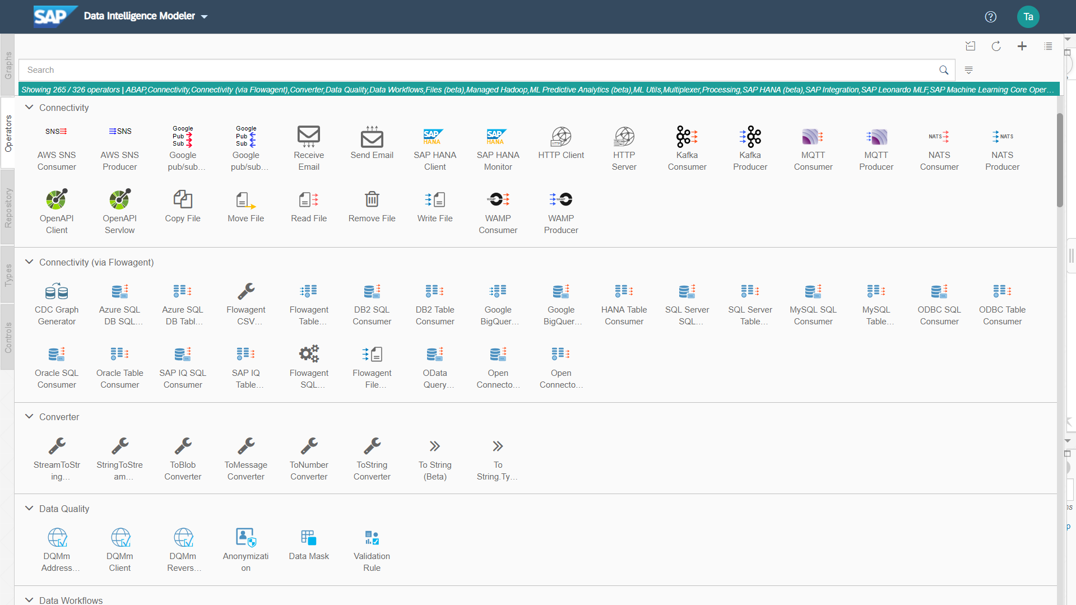
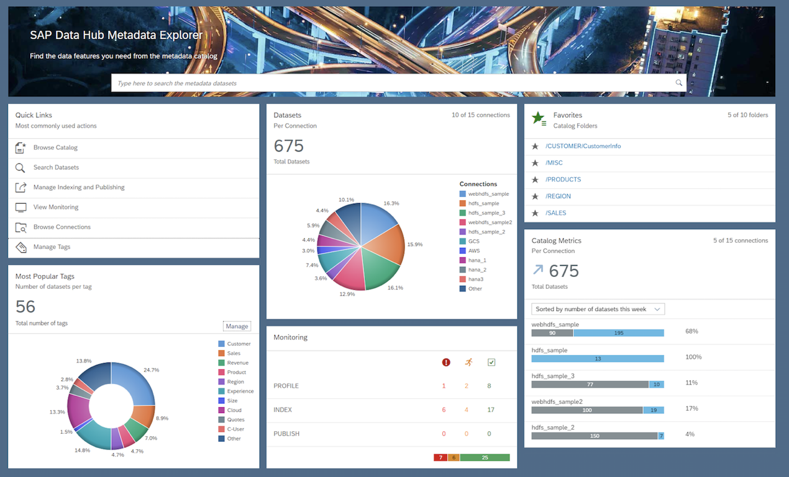
SAP Data Intelligence – Data Integration
Integrate any kind of data (structured, unstructured or streaming), with any pattern (real-time, near-real-time, batch), enrich it, refine it and feed process it

Slide 24
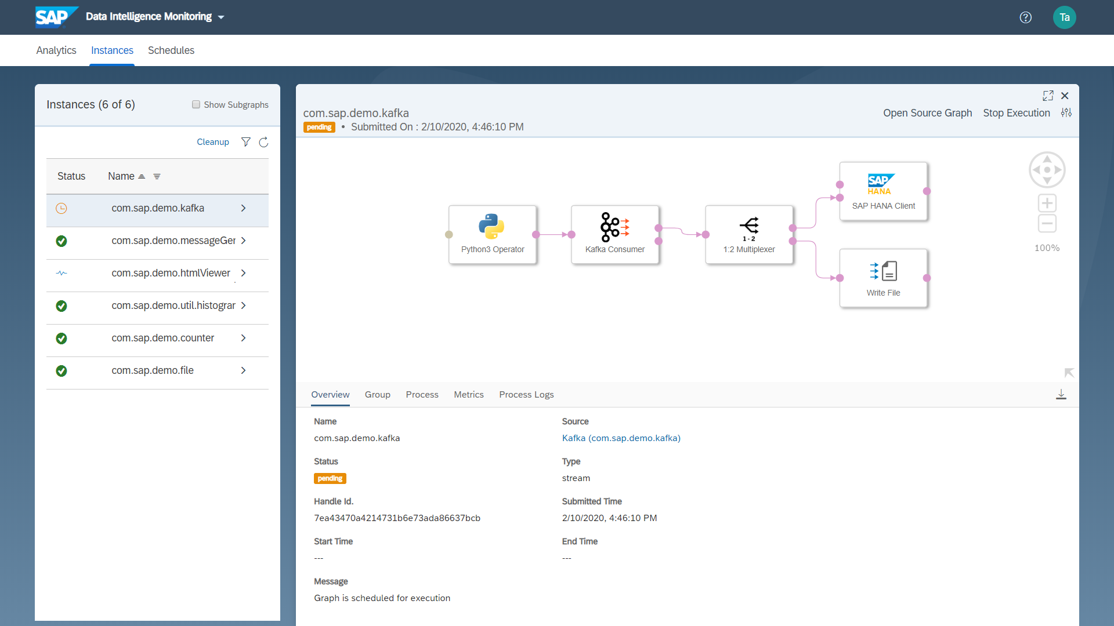
SAP Data Intelligence – Data Integration Connection Management, Data Workflows, Scheduling
Central management of all system connections
Connect to diverse systems natively and remotely
Support user access management
Data Workflows for cross-system data orchestration, e.g.
Trigger Execution of SAP BW process chains
Transfer data from SAP BW and SAP HANA
Execute remote SAP Data Services jobs
Trigger iFlows in SAP Cloud Integration
Submit Spark jobs to Hadoop clusters
Scheduling of Data Workflows
Extensive Monitoring
Support view, control, and auditing of data operation in the connected data landscape

Slide 25
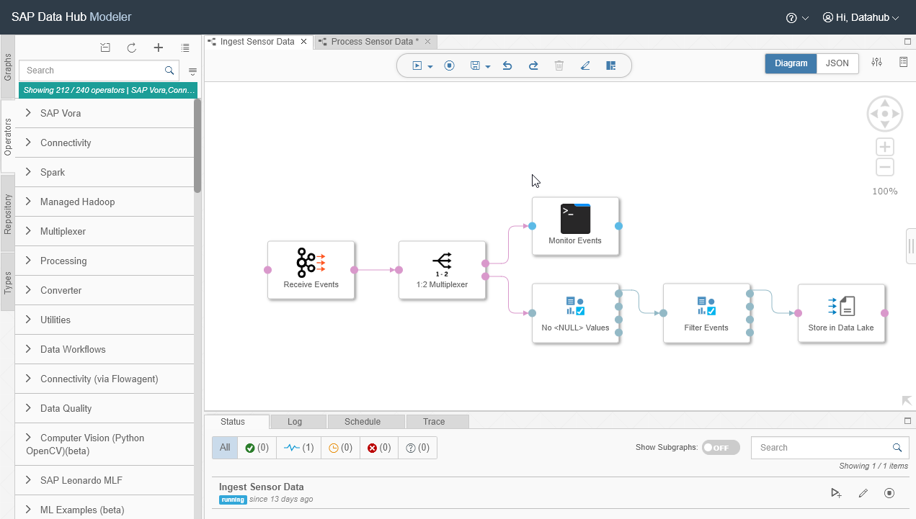
SAP Data Intelligence – Data Integration Build Flow-based Applications using the Pipeline Modeler
Data pipelines = Flow-based applications
Drag-and-drop operators (independent computation units)
Data (messages) flows between operators
Combine and switch between integration styles: streaming, batch, replication, virtualization, migration, etc.
Extensible
Over 250 pre-defined operators (data integration, connectivity, processing, data quality, ML . . .)
Custom and partner operators
Microservices via APIs
Wrap any scripting
Scalable
Containerized – Docker containers constitute the operators’ execution environments
Distributed – Easy horizontal scaling
Reusability
Create complex, multistep, reusable data pipelines and operators

Slide 26
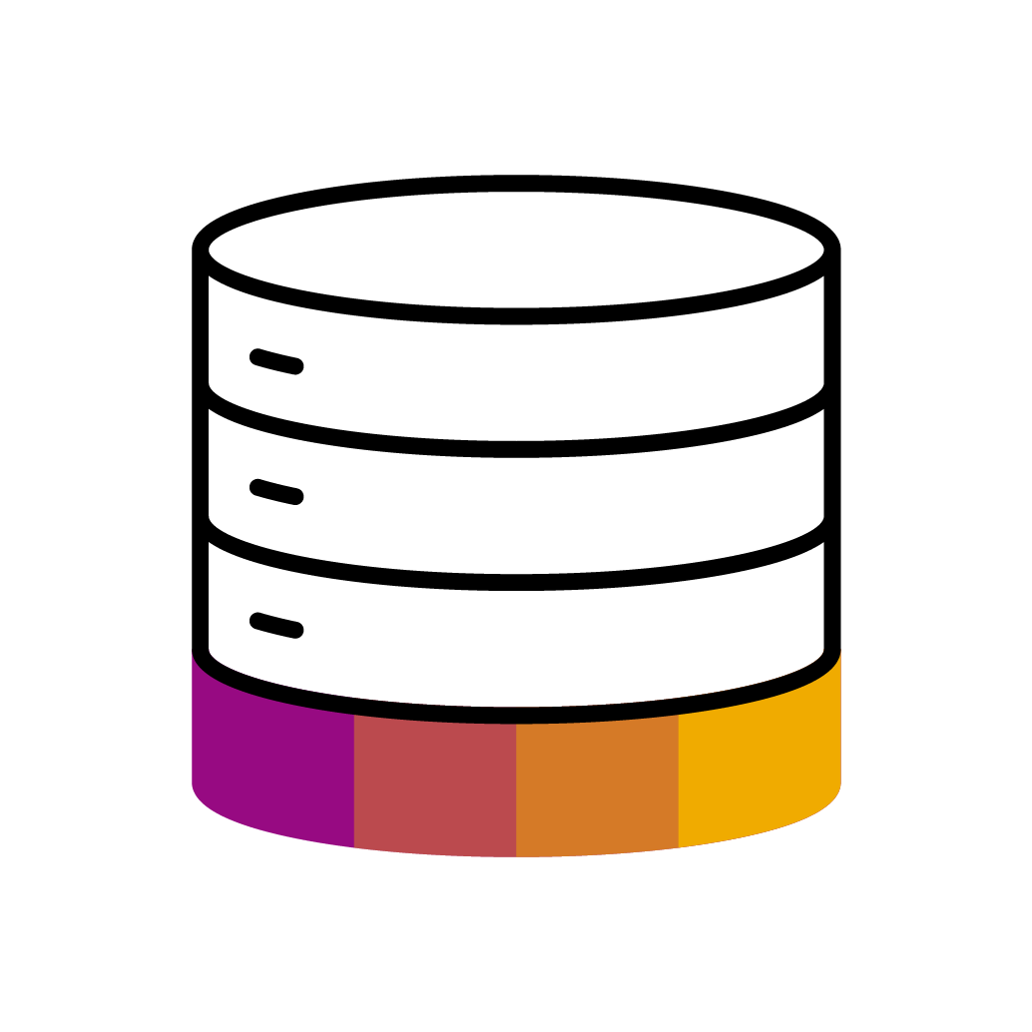
SAP Data Intelligence – Data Integration DI connectivity allows pipelining data across a wide variety of sources and targets
Structured Data
Unstructured Data
Streaming Data
Leonardo IoT Services
SAP SLT
Connector
SAP Custom
ABAP
SAP HANA
SAP CDS
Reader
SAP BW
SQL
Sever
DB2
SQL
Open API
Oracle
MySQL
Note: this slide represents only a non-exhaustive subset of the systems accessible via Data Intelligence
Notes:
When it comes to integrating, orchestrating and refining diverse data sources, SAP Data Intelligence has an impressive reach. In this slide we collected just a subset of some of the sources which you’ll find supported out of the box, which as you can see span from orchestrating BW or Data Services jobs on structured data sources, to integrating messages from all major IoT protocols, to exchanging data with all the native cloud storages of the hyperscalers.

Slide 27
SAP Data Intelligence
SAP Applications
Distributed & External Data Systems
SAP NetWeaver
+ DMIS Addon
ABAP Integration
Standard Connectors (open & native protocols)
SAP S/4HANA®
SAP Data Intelligence
Streaming (e.g. IoT)
SAP S/4HANA® CLOUD
Cloud Storages
SAP BW/4 HANA
SAP BW
BW Integration
Hadoop / HDFS
Cloud Data Integration
Data Integration
Data Ingestion / Data Enrichment / Data Workflows
REST APIs
SAP C/4HANA
Databases
…
Public Clouds
Data Processing
Exploration / Model Design / ML orchestration
3rd Party Connectors
Workflows
3rd Party Applications
BW Process Chains
Data Services Jobs
HANA Flowgraphs
SAP BTP Connectors
SAP API Business Hub
SAP Analytics Cloud
SAC Push API
Data Catalog
Data Discovery / Data Profiling / Metadata Cataloging
SCI for process integration
SAP HANA®
(on-premise, cloud, multi cloud)
SAP HANA Integration
SAP Open Connectors
Notes:
1) Expose the application data
Native integration into ABAP via ABAP Agent & proven technologies like SLT
For SCP-based and independent apps Cloud Data Integration API based on OData
Tight integration with HANA for certain scenarios
2) Provide business semantics via Metadata Management
Crawler enables to browse and discover data
Provide semantics of the data in Metadata Management
For S/4 (partly) automatic enrichment e.g. via DDIC, CDS …
3) Combine & enrich data from various applications & data sources in business scenarios
Cleanse data from your applications and combine & enrich with other data sources
Decide which data should be shared in the distributed datalake
4) Get control of the data processing via Pipelines
Built operators to natively integrate with your application (various languages & also embedded into ABAP)
Build pipelines & operators to do advanced data processing
5) Utilize the enriched data in Analytics Cloud, BW & Machine Learning
Enriched data in business scenarios can be used in analytical scenarios and machine learning scenarios
Direct integration with Analytics Cloud, BW/4 HANA and ML Foundation (later also DSP)
6) If you want to build a data-driven app utilize the full potential of Data Hub as a platform
Use the full potential of the Data Hub system management, Pipelines and the tight integration with SCP

Slide 28
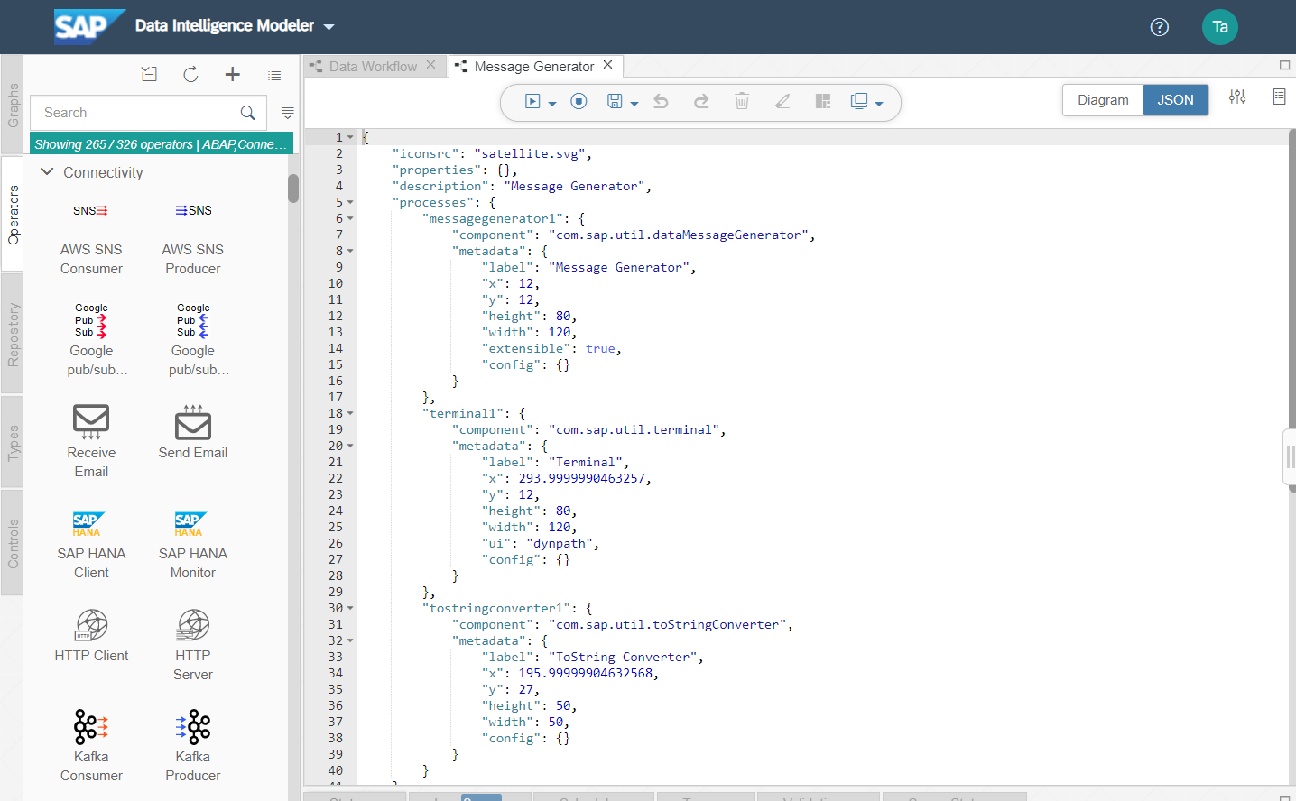
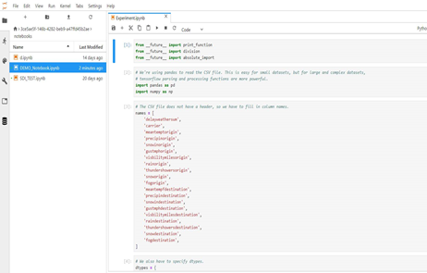
SAP Data Intelligence – Data Processing
Explore your data assets, create and validate your models, and orchestrate any mix of data processing engines, seamlessly within the data pipelines that feed them

Slide 29
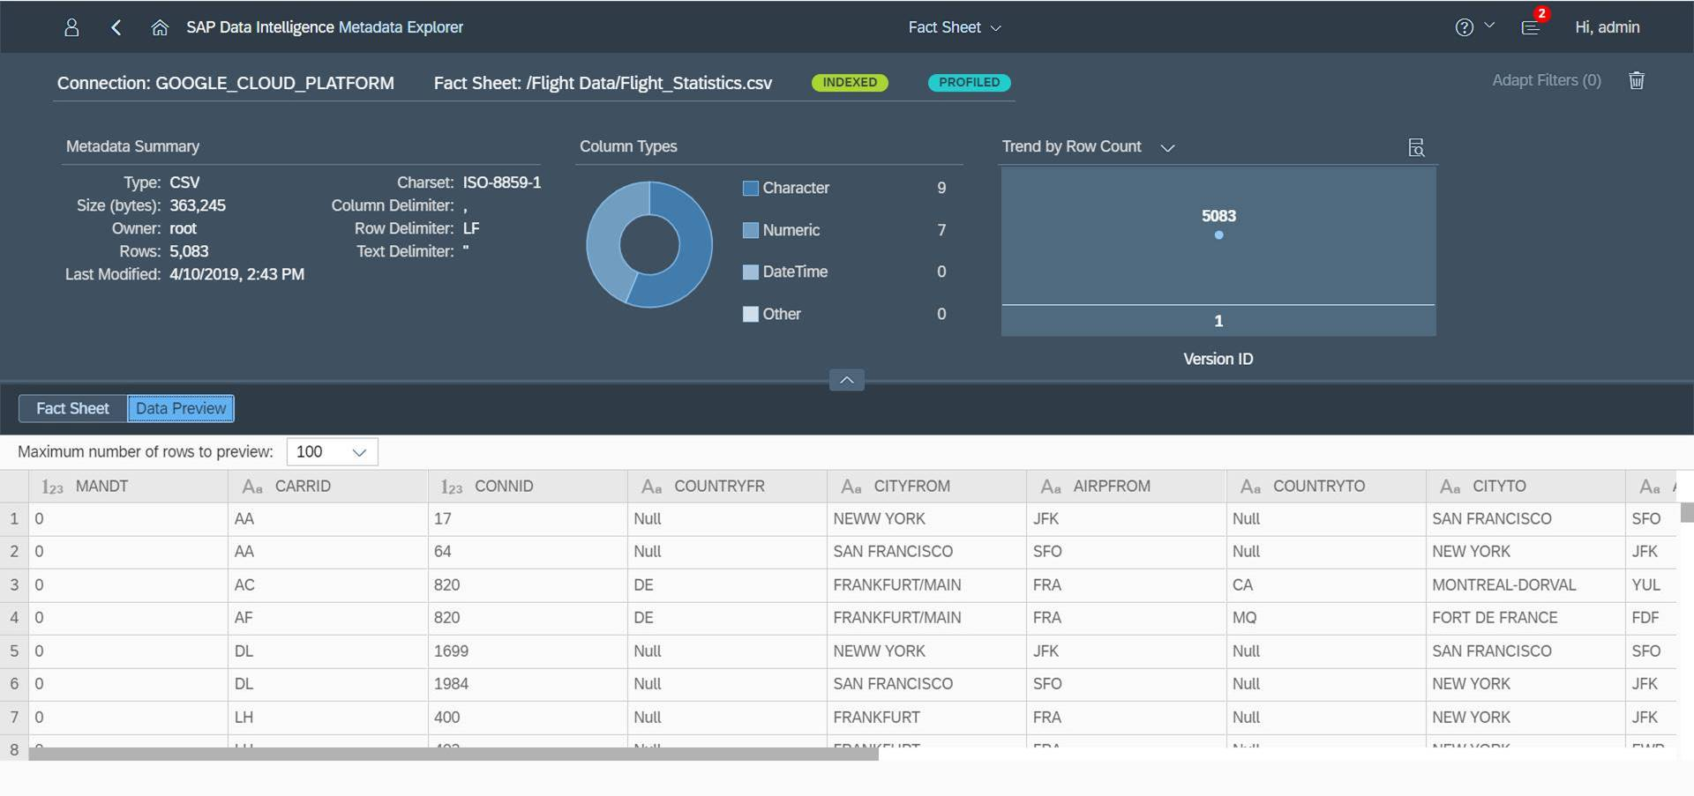
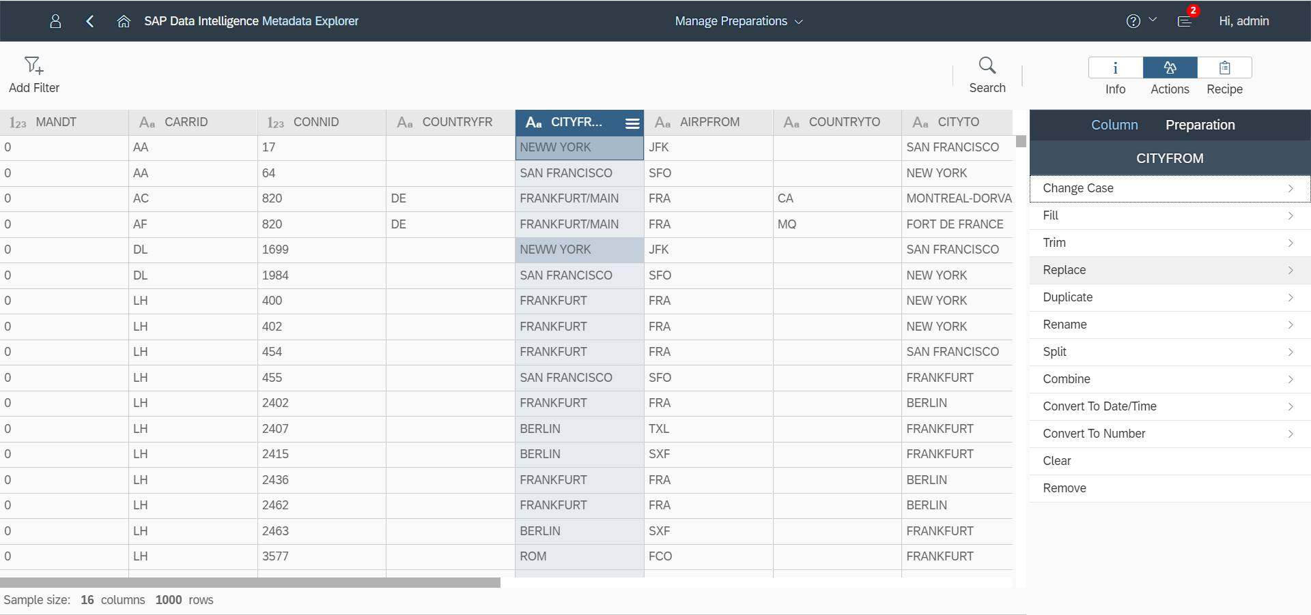
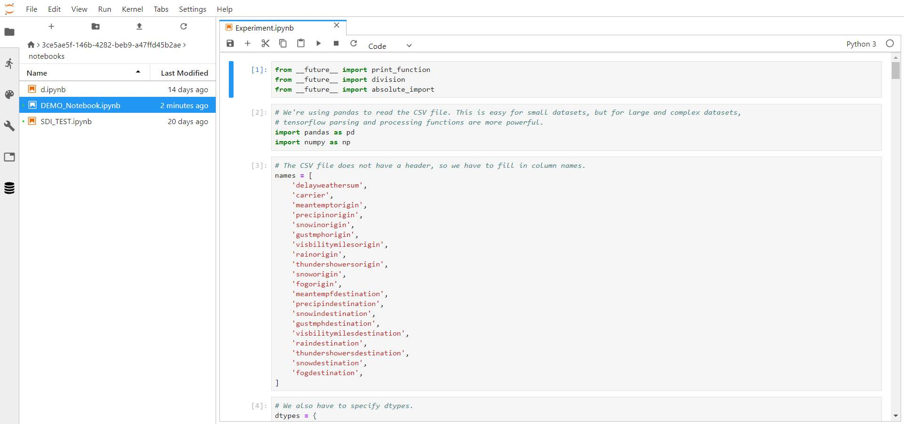
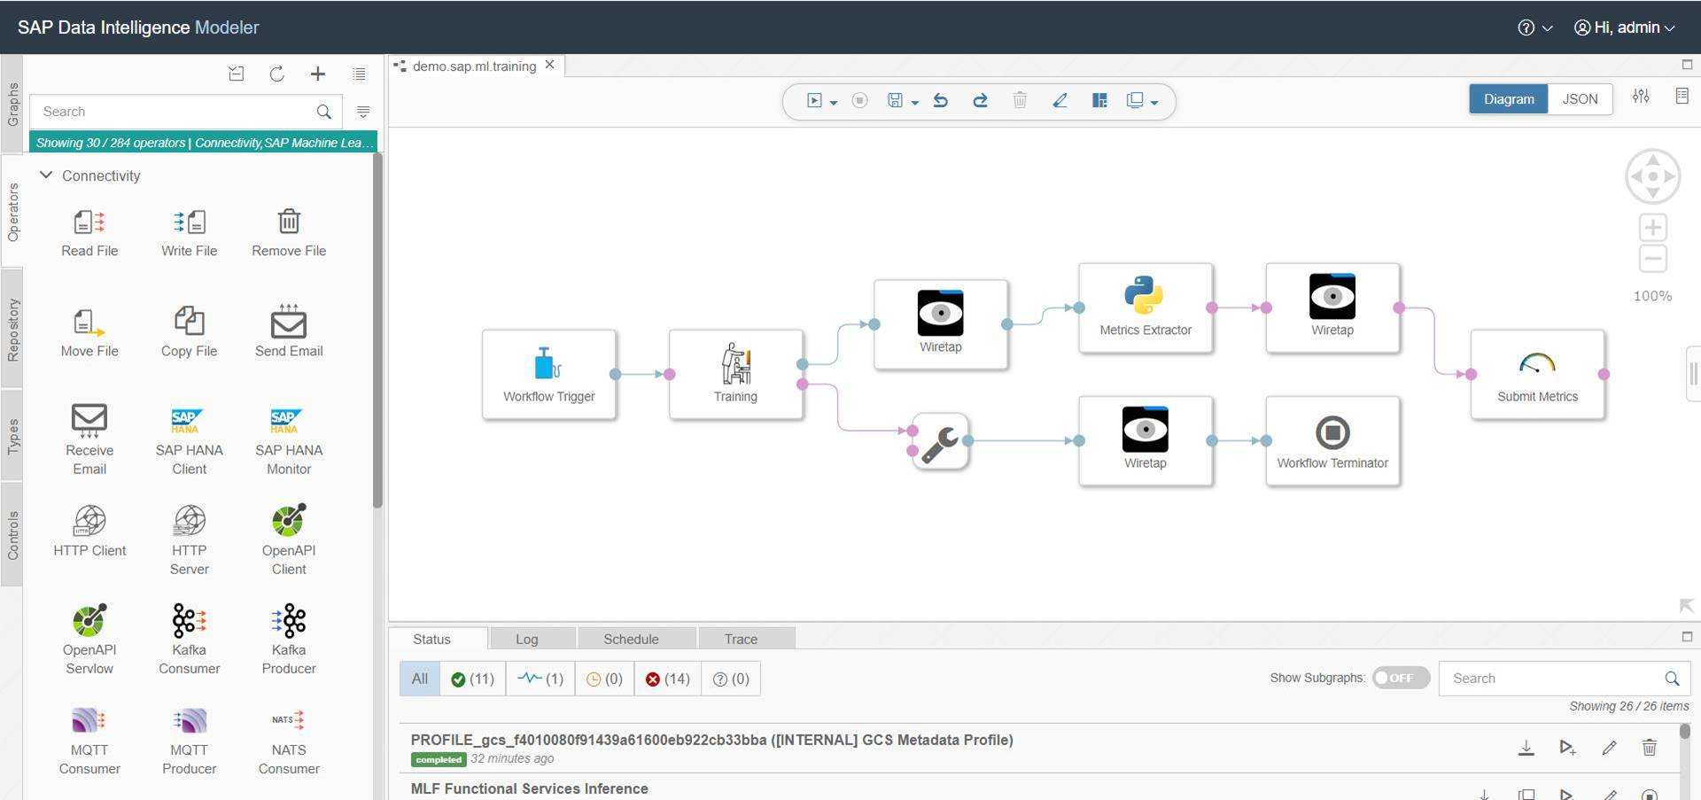
SAP Data Intelligence – Data Processing
Search & Browse Data
Connection /Storage Management
Data Preparation
Data Processing
Model
Creation
Model Training
Model Validation
Model Deployment
Integration into Application
Automation & Maintenance

Slide 30
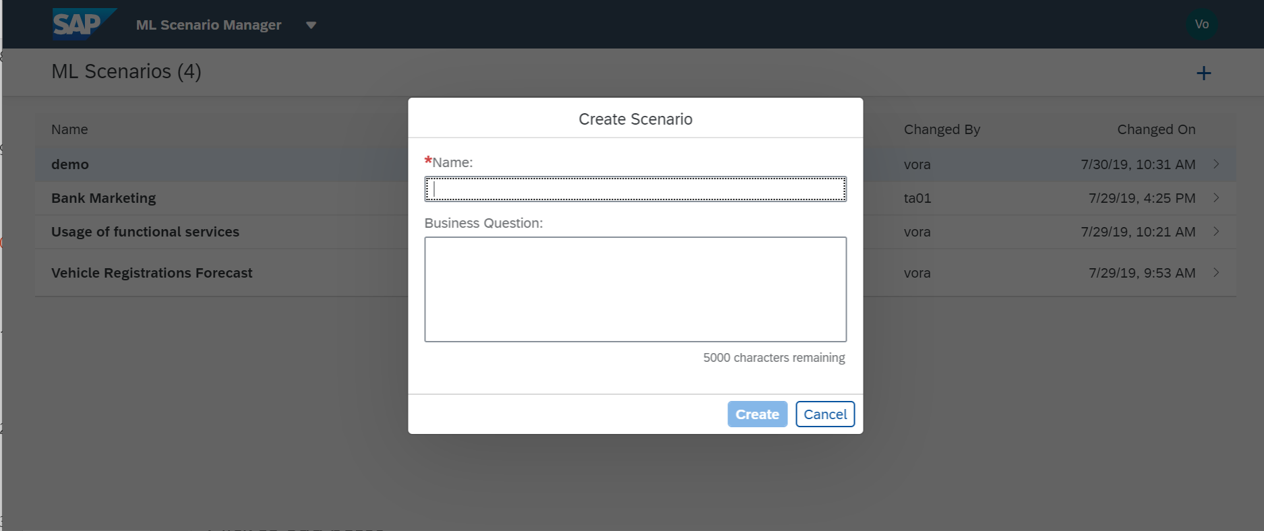
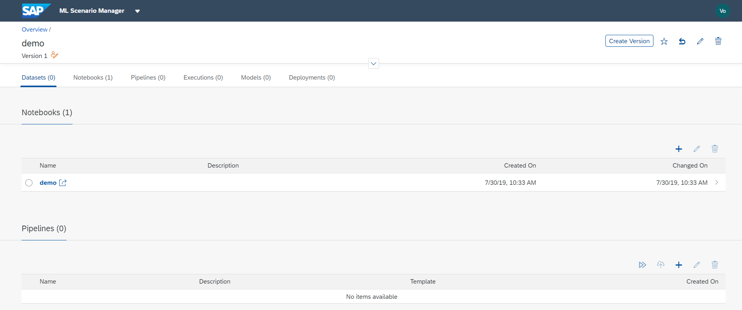
SAP Data Intelligence – Data Processing Machine Learning Scenario Manager
Automate low value tasks
Model performance and lifecycle can be managed so IT and data scientists can focus on the tasks that matter.
Manage everything at once
One single interface allows you to see and orchestrate all data-driven applications and data flows across the organization with tools to help manage governance, auditability, and transparency.
Configure the underlying data pipelines
Parameterize the underlying pipelines used for training and inference to gain flexibility in the deployment phase.

Slide 31
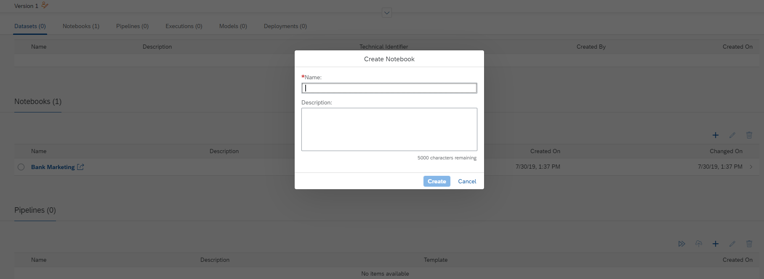
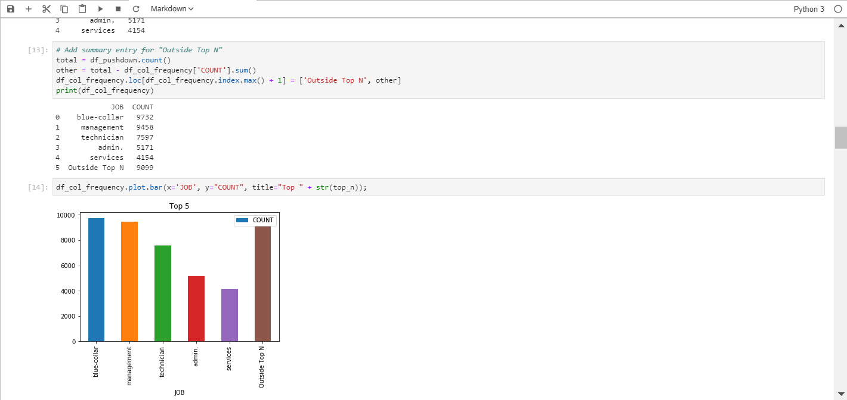
SAP Data Intelligence – Data Processing Juypter Lab environment
Leverage the experimental phase
Use interactive development environment to work with notebooks, code, and data. Use text editors, terminals, data file viewers, and other custom components side by side with notebooks in a tabbed work area.
Integrate the experimental phase
Harness the usage of Jupyter notebooks in data-driven applications by benefitting from the seamless integration of the JupyterLab environment and the pipeline modeler application.

Slide 32
SAP Data Intelligence – Data Processing Orchestration of heterogeneous processing engines within DI pipelines
SAP HANA Machine Learning
SAP HANA Graph
SAP HANA Streaming Analytics
SAP HANA Text Analytics
SAP AI Core
SAP Data Services
SAP
ENGINES
Apache Kafka
OPEN SOURCE
CNGINES
… across distributed infrastructures, cloud and on-prem, minimizing data movements
Notes:
Similarly, when it comes to processing the data, SAP Data Intelligence can natively execute and orchestrate processing jobs in HANA, as well as in all the major Open Source engines, like Python, Spark or Google TensorFlow. And it can do that across landscape which can include any of the hyperscalers, as well as on premise legs, using any of the supported Kubernetes infrastructure.
This capability to orchestrate both data integration and data processing, and to do it with a pure multi-cloud approach, agnostic to the infrastructure provider, is a very differentiating characteristic: no other Data Orchestration tool in the market can do the same!
Orchestrate your data using modular data pipelines with access to all data operations. Process the data where it resides, rapidly delivering intelligent and trustworthy data to the right users with the right context at the right time
Capabilities and Differentiators
Workflow scheduling and monitoring
Remote task execution
Data transfer between systems
Diverse processing engines
Modular data pipelines with access to all necessary data operations - from data ingestion to data sharing.
Simple, browser-based, single entry point for entire data orchestration that includes modeling, design, deployment, monitoring, task automation, distributed processing, system management.
Built-in operators which can be directly used in a pipeline or can be customized for specific use case.
Efficient data preparation and quality assurance
Effective raw data enrichment using business data
Powerful distributed data pipeline execution
Ability to combine and orchestrate Open Source frameworks (TensorFlow, R, Pything) and SAP frameworks (HANA APL/PAL, Machine Learning Foundation)
Benefits
Achieve excellence in customer engagement by responding to information and events with intelligent data and actions powered by trusted data and enhanced with machine learning
Accelerate intelligent data delivery for applications and users.
Build powerful data pipelines to handle data streams, preparation, transformations, and complex processing
Simplified data orchestration with full visibility into data across systems
High performance and scalable data operations for traditional and new data landscapes
Generate immediate business results with virtual modeling for faster delivery of intelligent data
Rapidly deploy comprehensive machine learning scenarios into production and managed from a single solution supporting all key users involved (Data Engineers, Data Scientists, Business Analysts, etc)

Slide 33
SAP Data Intelligence
SAP Applications
Distributed & External Data Systems
SAP NetWeaver
+ DMIS Addon
ABAP Integration
Standard Connectors (open & native protocols)
SAP S/4HANA®
SAP Data Intelligence
Streaming (e.g. IoT)
SAP S/4HANA® CLOUD
Cloud Storages
SAP BW/4 HANA
SAP BW
BW Integration
Hadoop / HDFS
Cloud Data Integration
Data Integration
Data Ingestion / Data Enrichment / Data Workflows
REST APIs
SAP C/4HANA
Databases
…
Public Clouds
Data Processing
Exploration / Model Design / ML orchestration
3rd Party Connectors
Workflows
3rd Party Applications
BW Process Chains
Data Services Jobs
HANA Flowgraphs
SAP BTP Connectors
SAP API Business Hub
SAP Analytics Cloud
SAC Push API
Data Catalog
Data Discovery / Data Profiling / Metadata Cataloging
SCI for process integration
SAP HANA®
(on-premise, cloud, multi cloud)
SAP HANA Integration
SAP Open Connectors
Notes:
1) Expose the application data
Native integration into ABAP via ABAP Agent & proven technologies like SLT
For SCP-based and independent apps Cloud Data Integration API based on OData
Tight integration with HANA for certain scenarios
2) Provide business semantics via Metadata Management
Crawler enables to browse and discover data
Provide semantics of the data in Metadata Management
For S/4 (partly) automatic enrichment e.g. via DDIC, CDS …
3) Combine & enrich data from various applications & data sources in business scenarios
Cleanse data from your applications and combine & enrich with other data sources
Decide which data should be shared in the distributed datalake
4) Get control of the data processing via Pipelines
Built operators to natively integrate with your application (various languages & also embedded into ABAP)
Build pipelines & operators to do advanced data processing
5) Utilize the enriched data in Analytics Cloud, BW & Machine Learning
Enriched data in business scenarios can be used in analytical scenarios and machine learning scenarios
Direct integration with Analytics Cloud, BW/4 HANA and ML Foundation (later also DSP)
6) If you want to build a data-driven app utilize the full potential of Data Hub as a platform
Use the full potential of the Data Hub system management, Pipelines and the tight integration with SCP

Slide 34
Data Catalog in the Enterprise
Understand
Prepare
Discover the data (crawl, profile, organize, link, enrich all your metadata)
Classify the data (auto-tagging based on data content and meaning)
Gain a deeper understanding of the data sources (location, attributes, quality, lineage, sensitivity, etc.)
Make data accessible (easily searchable, alongside its lineage, uses and value to the organization)
Enforce centralized authorization and security for data orchestration, data refinement, scheduling, and monitoring
Maintain critical controls over data standards, privacy and security
Collaboratively author, enhance, extend, and publish metadata for discovery and reuse
Search
Discover
Govern Access
Unified Data Catalog
Label & Tag
Curate
Organize
Transform
Crawl &
Index
Monitor
Publish, Share & Collaborate

Slide 35
SAP Data Intelligence – Data Catalog Metadata Management using the Meta Data Explorer
Discovery and profiling
Business glossary.
Collaborative rating and comments
Self-service data preparation
Data lineage
Data quality and business rules
Tight integration with data pipelines to streamline the end-to-end data-to-value workflow
SAP Data Intelligence
Metadata explorer
Discovery and profiling
Search
Lineage
Data preparation
Business rules
Data catalog
Metadata crawler
Manual definition
Connected Sources
Data intelligence sources
(DBS, SAP HANA, SAP BW, object stores, EDWS, WS/APIs, Hadoop, NOSQL, enterprise applications, dev platforms, APIs, SDK, …)
Other metadata repositories (SAP Information Steward, SAP PowerDesigner, SAP EA Designer, Atlas/Navigator, Hive, APIs …)
*This is the current state of planning and may be changed by SAP at any time without notice.

Slide 36
Data governance use cases
Data Discovery & Governance
Data Quality Monitoring
Data Preparation & Enrichment
Crawl, search, tag, profile, understand
Business rules, Data Quality dashboards
Acquire, refine, enrich

Slide 37
Search and filter across auto-discovered data assets
Filtering Connection or Dataset Types
Filtering With Tags

Slide 38
Link data to information-rich Business Terms
Common Properties and Definition
Custom Attributes to extend Business Term and add value
Relationships of Terms and Technical Artefacts

Slide 39
Profile data and get insights via the Fact Sheet
Columns Overview
Lineage Overview
Reviews Overview

Slide 40
Create and manage Data Quality Rules

Slide 41
Visualize data quality in easy-to-consume dashboards

Slide 42
Prepare and cleanse data via self-service data preparation

Slide 43
Agenda
SAP Data Intelligence Overview
Core capabilities of SAP Data Intelligence
Data Integration
Data Processing
Data Catalog
Key value-add scenarios for SAP customers
SAP integration
Data Management for SAP BTP
Hybrid Data Management
Deployment & Connectivity
Reference customers
Wrap up

Slide 44
SAP Data Intelligence – Key value-add scenarios for SAP customers

Slide 45
SAP Data Intelligence – Key value-add scenarios for SAP customers
SAP Data Intelligence
SAP Integration
Data Management for SAP BTP
Hybrid Data Management
Connect SAP applications at the ABAP layer, and reuse data semantics for all analytics
Single coherent cloud data management solution for the SAP BTP
Reuse all existing SAP tools and manage the end-to-end landscape
Notes:
SAP Business Technology Platform provides outcomes across 3 main customer scenarios.
Integration – complex IT landscapes include on premise and cloud systems, SaaS applications and hyperscaler technology. Integration is essential to enhance business operations across the entire value chain by connecting all systems seamlessly.
Data to Value – it’s essential that organizations have a consolidated view across all their data assets and are able to achieve insight and make real time decisions, especially during times of rapid change
Extensibility – companies need to stay agile and adapt rapidly to new business conditions and changing customer demands. Extension allows companies to build and enhance all their application investments to meet their customer’s dynamic needs and provide continual value.

Slide 46
SAP Data Intelligence – Data Integration for SAP applications Unified model to interact with SAP S/4HANA and SAP Business Suite software
One model to consolidate all interaction scenarios between SAP Data Intelligence and ABAP-based SAP software, directional and bidirectional
Capabilities
SAP S/4HANA
Provide ABAP metadata to the metadata explorer of SAP Data Intelligence.
SAP S/4HANA Cloud
ABAP functional execution is triggerable as an operator of SAP Data Intelligence.
SAP Business Warehouse
SAP Data Intelligence
ABAP data provisioning transfers data into SAP Data Intelligence.
SAP Business Suite
Integration requires a certain system level, planned for SAP S/4HANA 1909, SAP S/4HANA Cloud 1908, and SAP NetWeaver 7.00 with DMIS 2011/2018 Q4/2019 version, or higher. Certain functionality can be made available for SAP Data Intelligence for certain release levels.

Slide 47
SAP ABAP integration Technical concept: Repository
Modeler
ABAP operators
Predelivered operators in SAP software
Custom operators
ABAP pipeline engine
Repository with ABAP operators
Predelivered in SAP software
Custom operators
ABAP connection via RFC
“Shells” that point to the original implementation in the connected system
ABAP-based system
SAP Data Intelligence
ABAP integration

Slide 48
SAP ABAP integration Technical concept: Repository
Modeler
Read from CDS
ABAP pipeline engine
Pipeline
ABAP connection via RFC
ABAP-based system
SAP Data Intelligence
ABAP integration

Slide 49
SAP ABAP integration Technical concept: Delivery and releases
ABAP integration central note
SAP S/4HANA 1909 SAP S/4HANA Cloud
→ ABAP pipeline engine is included.
For all versions below 1909 and 2002, respectively, no (direct) support is possible.
SAP Business Suite (≥ SAP NetWeaver 7.0)
→ ABAP pipeline engine comes with DMIS.
SAP Data Intelligence
For all versions below release 7.0, no direct support is possible.
SAP Business Warehouse (≥ 7.30 SP14 )
SAP BW/4HANA*
ABAP pipeline engine comes with DMIS.
ABAP-based SAP software
* For SAP BW/4HANA, DMIS is already installed. If the DMIS release is below DMIS2011 SP17, you need to upgrade the functionality (ideally to the latest service package).

Slide 50
SAP Data Intelligence – Out-of-the box operators for SAP ABAP integration
Predefined ABAP operators to consume and interact
ABAP CDS view reader
Operator that supports initial load and delta replication of CDS views.
SLT connector operator
Operator to communicate with SAP Landscape Transformation Replication Server;
leverage existing replication scenarios to bring data into SAP Data Intelligence pipelines
Operator that can read from operational data provisioning out of SAP Business Warehouse or SAP BW/4HANA into SAP Data Intelligence
ODP reader
Custom ABAP operator
Operator to implement your ABAP custom code that will be executed as part of a pipeline in the connected ABAP system – for example, to call a function module
Integration requires a certain system level, planned for SAP S/4HANA 1909, SAP S/4HANA Cloud 1908, and SAP NetWeaver 7.00 with DMIS 2011/2018 Q4/2019 version, or higher. Certain functionality can be made available for SAP Data Intelligence for certain release levels.

Slide 51
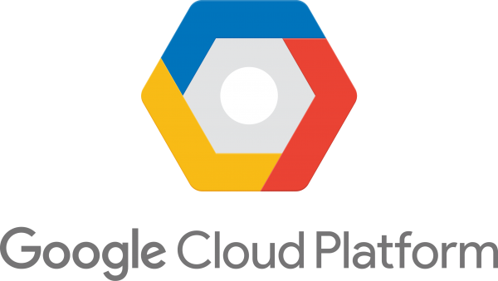
SAP ABAP Integration – ABAP CDS Reader
ABAP CDS is the semantically rich data model in SAP S/4HANA and allows the consistent representation of a business object such as a business partner.
ABAP CDS layer
Application table
ABAP pipeline engine
Initial load and
inserts, updates, deletes
DB triggers
DB triggers
SAP Data Intelligence
CDC engine
SAP S/4HANA 1909 SAP S/4HANA Cloud
The ABAP CDS reader operator allows the replication of ABAP CDS views from SAP and from customers in initial load and delta mode.

Slide 52
SAP ABAP Integration – SLT Connector Data provisioning for SAP S/4HANA and SAP Business Suite
The SLT connector operator establishes a communication to the remote ABAP system and consumes data (initial load and delta) via SAP Landscape Transformation Replication Server. This allows the consumption of business data directly within a data hub pipeline to leverage a tight integration between business data and Big Data.
Read engine
SAP Landscape Transformation Replication Server
Application tables
Logging
tables
Table replication
DB triggers
SAP S/4HANA 1909
SAP Business Suite
SAP Data Intelligence

Slide 53
SAP ABAP Integration – SLT Connector Deployment options
SAP S/4HANA 1909
SAP Landscape Transformation
Replication Server
Use SAP Landscape Transformation Replication Server as part of your productive SAP S/4HANA system. The SLT functionality is already included in the SAP S/4HANA stack.
SAP Data Intelligence
SAP Business Suite ≥SAP NetWeaver 7.00
DMIS 2011 SP17 or
DMIS 2018 SP02
SAP Landscape Transformation
Replication Server
Use SAP Landscape Transformation Replication Server as part of your productive SAP Business Suite software. This requires the installation of the DMIS functionality.
SAP Data Intelligence
SAP Data Intelligence
Extend your existing, separate SAP Landscape Transformation Replication Server leveraged for other replication needs in your landscape (such as the replication of SAP HANA) with the replication to SAP Data Intelligence.
Enable data provisioning to SAP Data Intelligence from SAP solutions with a low release level (SAP NetWeaver <7.00 and SAP S/4HANA <1909).
SAP S/4HANA <=1909
SAP Business Suite
SAP Landscape Transformation
Replication Server
≥SAP S/4HANA 1909 or
≥SAP NetWeaver 7.00 + DMIS**
SAP HANA
SAP Business Warehouse
…

Slide 54
SAP ABAP Integration – ODP Reader Data provisioning for SAP Business Warehouse
The use of the ODP reader allows you to extract any data object supported by the operational data provisioning framework (such as DSO). This operator is positioned to provision data out of SAP Business Warehouse to SAP Data Intelligence based on initial loads or delta replication.
Operational data provisioning
Any subgraph
ODP reader
Python
Azure
SAP Business Warehouse ≥730 SP14
SAP BW/4HANA
SAP Data Intelligence

Slide 55
SAP ABAP Integration – Custom ABAP operator Execute custom code and function modules
Custom ABAP operators can be used to enhance the scope of a data-driven application. For example, it is necessary to execute a function module within a pipeline to read data into SAP Data Intelligence, post information into an ABAP-based SAP solution, or trigger an execution in the remote system.
1
Execution of a pipeline
2
Execution of ABAP code
ABAP pipeline engine
SAP Data Intelligence
SAP S/4HANA 1909
SAP Business Suite (SAP NetWeaver 7.0+ and DMIS*)
Capabilities
Build customer operators to execute any kind of code.
Execute ABAP code in remote system.
Enable exchange of data and results if required.
* DMIS 2011 SP18 or DMIS 2018 SP2

Slide 56
SAP Data Intelligence – Key value-add scenarios for SAP customers
SAP Data Intelligence
SAP Integration
Data Management for SAP BTP
Hybrid Data Management
Connect SAP applications at the ABAP layer, and reuse data semantics for all analytics
Single coherent cloud data management solution for the SAP BTP
Reuse all existing SAP tools and manage the end-to-end landscape
Notes:
SAP Business Technology Platform provides outcomes across 3 main customer scenarios.
Integration – complex IT landscapes include on premise and cloud systems, SaaS applications and hyperscaler technology. Integration is essential to enhance business operations across the entire value chain by connecting all systems seamlessly.
Data to Value – it’s essential that organizations have a consolidated view across all their data assets and are able to achieve insight and make real time decisions, especially during times of rapid change
Extensibility – companies need to stay agile and adapt rapidly to new business conditions and changing customer demands. Extension allows companies to build and enhance all their application investments to meet their customer’s dynamic needs and provide continual value.

Slide 57
SAP Business Technology Platform The Platform for the Intelligent Enterprise
BUSINESS NETWORK
BUSINESS PROCESS
ACROSS ALL FUNCTIONS
EXPERIENCE MANAGEMENT
APPLICATIONS
INTELLIGENT SUITE
INDUSTRY CLOUD
SUSTAINABILITY MANAGEMENT
SAP BUSINESS TECHNOLOGY PLATFORM
TECHNOLOGY
DATABASE & DATA MANAGEMENT
ANALYTICS
APPLICATION DEVELOPMENT & INTEGRATION
INTELLIGENT TECHNOLOGIES
Notes:
SAP BTP is the platform for the intelligent enterprise. It includes database and data management solutions, analytics, application development & integration, as well as intelligent technologies – from on-premise to the cloud.
SAP BTP technologies provide substantial value individually (such as SAP HANA), however, the real power of the platform lies in leveraging a combination of technologies to solve your business challenges and create innovative outcomes
Our customers can run SAP BTP in any cloud environment, to achieve ultimate flexibility and choice to drive agility & speed. This is a big differentiation offered only by SAP. We take care of the technology so you can focus on your business outcomes.
SAP has a unique position to address your challenges with in-depth insight and access into business data and processes. This allows organizations to focus on business outcomes, instead of on the technical building blocks.
SAP BTP integrates and extends SAP Intelligent Suite as well as third-party applications with innovative capabilities.
With SAP’s strong business and technology assets, and our close collaboration with customers and partners, SAP is uniquely positioned to deliver a business technology platform that helps enterprises achieve data-driven innovation

Slide 58
SAP Data Intelligence, a pillar of the SAP BTP Enabling and end-to-end data fabric
SAP Analytics Cloud
Business Intelligence
Augmented Analytics
Enterprise Planning
SAP Data Warehouse Cloud
SAP Data Intelligence Cloud
*
3rd party data catalogs
Business Layer
SAP BTP – Data Management & Analytics
Data Spaces
Data Catalog
3rd party processing engines
SAP HANA Cloud
Orchestration
Multi-model Engines
Integration
3rd party data lakes
Tiered Data Storage
SAP Applications
Non-SAP Applications
Unstructured data
Streaming data
*planned

Slide 59
SAP Data Intelligence and the BTP Data Management & Analytics tools Integration scenarios
SAP Analytics Cloud
SAP Data Warehouse Cloud
SAP HANA Cloud
SAP HANA
Story
Table
Graphical view
SQL View
Virtual tables
Virtual tables
Data set
Model
Open SQL schema
Views
Tables
Views
Tables
Smart data integration
Currently only with OpenSQL Schema
Modeler
Metadata catalog
Profiling, discovery
FlowAgent subengine
Main engine
Workflows
Push operator for SAP Analytics Cloud
Table consumer operator
Table producer operator
SQL executor operator
Table replicator operator
Client operators for SAP HANA
ML operators for SAP HANA
Flowgraph Operator for SAP HANA
Lineage
extraction
Data preparation
Metadata explorer
SAP Data Intelligence
Notes:
SAP HANA Integration
Pipeline Operators:
SAP HANA Client – Flexible client operator to interact with SAP HANA from within data pipelines
SAP HANA Table Consumer – Pull data (table, view) from SAP HANA optimized for ETL scenarios
SAP HANA Monitor – Watch SAP HANA table for changes and output newly inserted rows
SAP HANA Flowgraph (Workflow) – Orchestrate SAP HANA flowgraph using SDI REST API (XSC)
Data Transfer (Workflow) – Transfer data (table, view) from SAP HANA into big data stores
Smart Data Access
Access data being stored in SAP Data Intelligence persistency engines (SAP Vora) virtually from within SAP HANA via remote source to SAP Vora.
SAP Analytics Cloud
Pipeline Operator:
SAP Analytics Cloud Producer – Push data into SAP Analytics Cloud (dataset) from within a data pipeline
Smart Data Access:
Access virtual table on SAP Vora in SAP HANA via HANA live connection.

Slide 60
SAP Data Intelligence and SAP HANA Cloud
SAP HANA Cloud
Metadata catalog
Profiling, discovery
Create
SAP HANA
Table
Views
Virtual table
Lineage
extraction
Data preparation
Metadata explorer
Read
Delete
Update
SAP HANA
SAP HANA
SAP HANA
SAP HANA
SAP HANA
Modeler
SAP Data Intelligence

Slide 61
Data Intelligence orchestrating Machine Learning models on HANA Cloud
Supported machine learning tasks
SAP Data Intelligence
SAP HANA
SAP HANA
SAP HANA
Classification
ML training
ML inference
ML forecast
Regression
Machine learning operators on SAP HANA Cloud
Jupyter lab
Time-series forecasting
SAP HANA Cloud
Trigger remote ML, data processing in SAP HANA Cloud through Python client for SAP HANA
Embedded machine learning
Cluster analysis
Predictive algorithm library (PAL)
Automated predictive library (APL)

Slide 62
Data Intelligence and DWC Why move from Data Flow (aka DI embedded) to DI full use
Data Flow in Data Warehouse Cloud
Data Intelligence Cloud
Load data into DWC simply, at no additional cost without any additional external tools required (i.e. SAP Data Services, Informatica, SnapLogic etc.)
Streamline all data integration needs, covering all scenarios also beyond ingestion into DWC
Enhance reporting by integrating any kind of data (including streaming and any unstructured) and orchestrating any kind of processing (including ML and external engines) into your DWC environment
Trust the accuracy of your data in DWC with robust metadata management and data quality
Create an enterprise data fabric to catalog and access data from DWC and all other data sources in your organization
Move from real-time reporting to real time business process improvement through data orchestration, and integration towards middlewares and applications

Slide 63
Data Intelligence integration with SAP Analytics Cloud Integration of SAP Data Intelligence and SAP Analytics Cloud
SAP Analytics Cloud
Story
Create “on the fly”
Data set
Push result set to SAP Analytics Cloud
using a dedicated API for SAP Analytics Cloud
Create
Model
Create
Specify host for SAP Analytics Cloud and OAuth2 Client information
Modeler
SAP Data Intelligence

Slide 64
SAP Data Intelligence – Key value-add scenarios for SAP customers
SAP Data Intelligence
SAP Integration
Data Management for SAP BTP
Hybrid Data Management
Connect SAP applications at the ABAP layer, and reuse data semantics for all analytics
Single coherent cloud data management solution for the SAP BTP
Reuse all existing SAP tools and manage the end-to-end landscape
Notes:
SAP Business Technology Platform provides outcomes across 3 main customer scenarios.
Integration – complex IT landscapes include on premise and cloud systems, SaaS applications and hyperscaler technology. Integration is essential to enhance business operations across the entire value chain by connecting all systems seamlessly.
Data to Value – it’s essential that organizations have a consolidated view across all their data assets and are able to achieve insight and make real time decisions, especially during times of rapid change
Extensibility – companies need to stay agile and adapt rapidly to new business conditions and changing customer demands. Extension allows companies to build and enhance all their application investments to meet their customer’s dynamic needs and provide continual value.

Slide 65
SAP Data Intelligence enabling Hybrid Data Management Transition to Cloud Data Management at your own pace
End-to-end data fabric across hybrid landscapes
SAP Data Services
3rd Party
Safeguard past investments by reusing existing assets
SAP HANA
Open Source
SAP Data Intelligence
Modernize landscape without disruption ​
SAP LT Replication Server
SAP Information Steward
Cloud elasticity & agility​
SAP Integration Suite

Slide 66
SAP Data Intelligence enabling Hybrid Data Management Leverage existing SAP EIM tools
Orchestration
3rd Party Meta Integration Technology Inc.
3rd Party Partner
Metadata
Metadata
SAP Data Intelligence
Common Connections [Data Lake]
Operationalization
Support Wide
Span of Data
SAP Data Services
SAP Information Steward
SAP Data Intelligence
Extend reach of Data Services assets across diverse system landscapes​
Orchestrate Data Services jobs within Data Intelligence pipelines ​
Enhance enterprise business processes with high value data and insights from external systems
Reuse Information Steward rules within Data Intelligence​
Shared glossary of terms​
Metadata shared across applications, augmented by ML learning models​

Slide 67
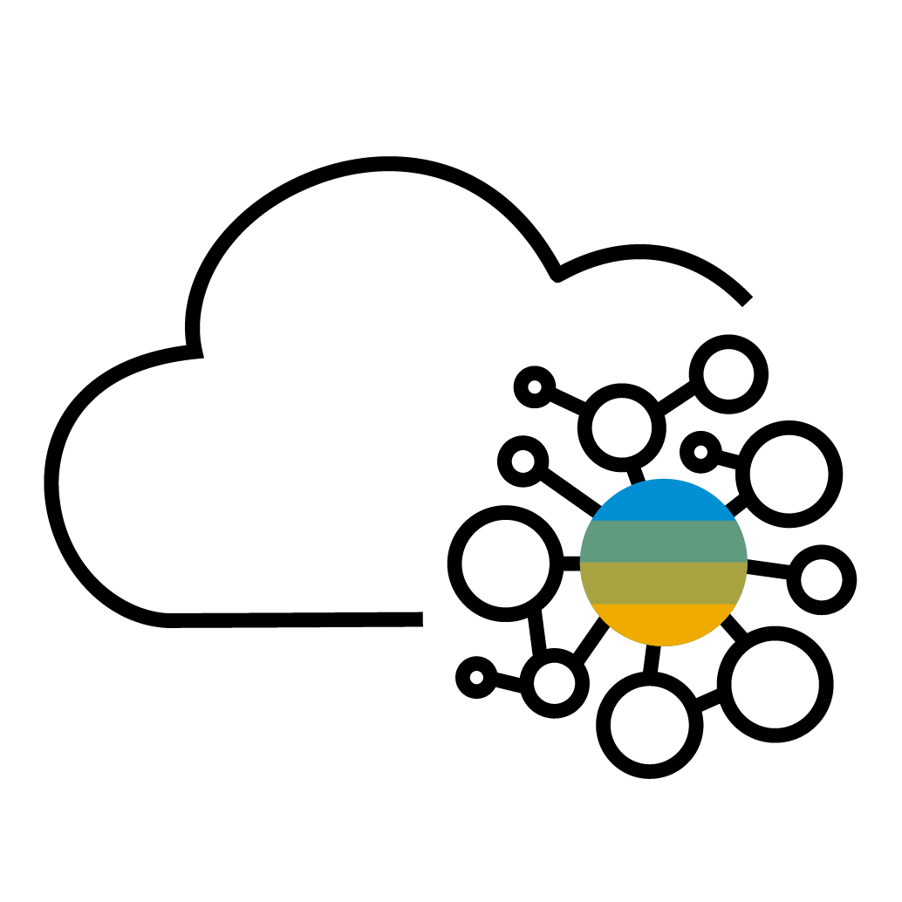
SAP Data Intelligence and SAP Data Services Reuse DS to feed enriched data to Data Intelligence
Use case description
Making EIM-enriched data easily available to SAP Data Intelligence software connections
Minimizing impact on the current EIM implementations
Orchestrating SAP Data Services software jobs as a part of the SAP Data Intelligence software pipeline
Business value – Benefits
Enables users to consume EIM processed data from SAP Analytics Cloud, Kafka, and other unique SAP Data Intelligence software targets
Integrates all the sources and targets supported by SAP Data Services and SAP Data Intelligence in a single pipeline with distributed processing
Enables the use of existing SAP Data Services software jobs
Allows direct consumption of IS rules for data validations and enrichments within SAP Data Services
Gives users choice of the data lake infrastructure, either on-premise or cloud
SAP Data Intelligence
Common connections [data lake]
SAP Data Services
Use case example
Identify the ETL flows and data sets from existing data warehouses populated by SAP Data Services.
Extend the output of the SAP Data Services software flows to common connections, data lake.
Build SAP Data Intelligence software pipeline to orchestrate the SAP Data Services software flows and read from common connections in new SAP Data Intelligence software operators.
As a part of the SAP Data Intelligence software pipeline, publish the ready-to-consume data to SAP Analytics Cloud and Kafka, and any other open connectors.
Notes:
The two liner message in this slide:
This proposal is to optimally use the existing Data Services assets and infrastructure, not only , for the on-premise and current EIM capability, but to extend EIM processed rich information, integrated with new age data systems and data formats addressed by Data Intelligence.
Your EIM investment is not a throw away, and also, embracing the new age systems on a single pipeline, is within simple reach.
BUSINESS VALUE – BENEFITS
Enables users to consume information from endpoints where Data Services cannot reach. Like SAC, Kafka and other unique DI targets
All the sources and targets supported by DS and DI become accessible collectively in a single pipeline. This is because the Hybrid approach allows seamless data movement possibilities across the collective connections. All the sources and targets supported by DS and DI can be used in a single pipeline with distributed processing.
Leverages the enriched and quality added data to be consumed for publishing in SAC and Kafka
Integrate legacy information as is, with upcoming data systems in a DI pipeline. No need to re-invent the wheel of Legacy and enterprise data transformation. Reduces the project timeline for Data Intelligence for on premise data procurement and transformation. Eliminates the logic wheel re-invention on enterprise data. Like reading VSAM data with Cobol copybook
Direct consumption of IS rules for DQ validations and enrichments within Data Services
Users choice of the Data Lake infrastructure, either on-premise or cloud.
Foundation of ‘data exchange’ that can serve as the core platform for Metadata explorer in DI

Slide 68
SAP Data Intelligence and SAP Data Services Use DI to feed ML-processed data back to DS
Use case description
Enriching legacy data based on machine learning models
Integrating valuable external data into legacy data
Leveraging SAP Data Services software data standardization, cleansing and enrichment in SAP Data Intelligence software pipelines
Business value – Benefits
Enables valuable foreign data absorption in legacy systems as a reverse cycle
Enables learning model data enrichment for legacy systems as well as new age systems
Allows data synchronization, standardization, and harmonization between legacy and new age system
Enables template-based data quality validations and corrections
SAP Data Intelligence
Common connections [data lake]
SAP Data Services
Use case example
Identify high-value data from external systems integrated by SAP Data Intelligence and feed back to data lake for integrating with enterprise data by SAP Data Services.
Apply data format interchange with SAP Data Services for integrating with enterprise or legacy data.
Leverage SAP Data Services software transforms by invoking predefined template dataflows.
Notes:
The two liner message in this slide:
This proposal is to optimally use the existing Data Services assets and infrastructure, not only , for the on-premise and current EIM capability, but to extend EIM processed rich information, integrated with new age data systems and data formats addressed by Data Intelligence.
Your EIM investment is not a throw away, and also, embracing the new age systems on a single pipeline, is within simple reach.
BUSINESS VALUE – BENEFITS
Enables users to consume information from endpoints where Data Services cannot reach. Like SAC, Kafka and other unique DI targets
All the sources and targets supported by DS and DI become accessible collectively in a single pipeline. This is because the Hybrid approach allows seamless data movement possibilities across the collective connections. All the sources and targets supported by DS and DI can be used in a single pipeline with distributed processing.
Leverages the enriched and quality added data to be consumed for publishing in SAC and Kafka
Integrate legacy information as is, with upcoming data systems in a DI pipeline. No need to re-invent the wheel of Legacy and enterprise data transformation. Reduces the project timeline for Data Intelligence for on premise data procurement and transformation. Eliminates the logic wheel re-invention on enterprise data. Like reading VSAM data with Cobol copybook
Direct consumption of IS rules for DQ validations and enrichments within Data Services
Users choice of the Data Lake infrastructure, either on-premise or cloud.
Foundation of ‘data exchange’ that can serve as the core platform for Metadata explorer in DI

Slide 69
SAP Data Intelligence and SAP Information Steward Reuse IS data quality rules in DI
Use case description
Reuse approved SAP Information Steward software rules within SAP Data Intelligence
Share rules between SAP applications
Approved rules
Approval workflow
Support wide
span of data
Business value – benefits
Enables validation and quality rules to apply to a widely expansive cloud and on premise of sources and applications
Allows substantial reduction of time to redevelop rules while gaining faster insight into quality and trustworthiness of newly added sources and applications
Improves governance and quality control by sharing, maintaining, managing, and governing all rules
Increases collaboration between users, as well as SAP applications
Provides quick-start data quality initiatives with sharing of approved rules
Has burst computation with cloud deployment with pay-as-you-go model
SAP Information Steward
Data insight
SAP Data Intelligence
Learning models
Use case example
Define and approve validation and quality rules in SAP Information Steward.
Execute rules against connected sources of SAP Information Steward.
Export rules of SAP Information Steward.
Import rules of SAP Information Steward into SAP Data Intelligence.
Reuse rules of SAP Information Steward within SAP Data Intelligence against additional sources, such as cloud sources.
Notes:
Automotive

Slide 70
SAP Data Intelligence and SAP Information Steward Reuse IS business terms in DI
Use case description
Automatically use approved terms of SAP Information Steward within SAP Data Intelligence.
Share terms between SAP applications.
Approved terms
Approval workflow
Support wide
span of data
Business value – benefits
Enables glossary terms to apply to a widely expansive cloud and on premise of sources and applications
Allows substantial reduction of time to redevelop terms while gaining faster insight into newly added sources and applications
Improves governance and transparency with common understanding and agreement on business taxonomies across all sources and applications
Promotes proactive data governance with shared glossary terms to maintain, manage, and govern all terms
Increases collaboration between users, as well as SAP applications
Has burst computation with cloud deployment with pay-as-you-go model
SAP Information Steward
Metapedia
SAP Data Intelligence
Learning models
Use case example
Define and approve terms in SAP Information Steward.
Associate terms of SAP Information Steward with validation and quality rules, metadata objects, information policies, and terms.
Export terms of SAP Information Steward.
Import terms of SAP Information Steward into SAP Data Intelligence.
Reuse terms of SAP Information Steward within SAP Data Intelligence against additional sources and metadata objects.
Notes:
Automotive

Slide 71
Agenda
SAP Data Intelligence Overview
Core capabilities of SAP Data Intelligence
Data Integration
Data Processing
Data Catalog
Key value-add scenarios for SAP customers
SAP integration
Data Management for SAP BTP
Hybrid Data Management
Deployment & Connectivity
Reference customers
Wrap up

Slide 72
Deployment options

Slide 73
SAP Data Intelligence – Deployment Options
SAP Data Intelligence
on-premise
full managed cloud service on SAP BTP
SAP Business Technology Platform
Gardener
Kubernetes
On-premise
installations
public cloud
Kubernetes service
private cloud
public cloud

Slide 74
SAP Data Intelligence – Deployment Options
SAP Data Intelligence
SAP Data Intelligence
Product
on premise
as-a-service
Kubernetes Deployment Type
Kubernetes as-a-service
Kubenetes on-premise
SAP BTP with Gardener
Kubernetes Environment
AWS EKS*
Azure AKS*
Google Cloud GKE*
...
Suse CaasP*
RedHat Open Shift*
Cisco CP*
Virtu- stream*
AWS* Gardener
Azure* Gardener
...
Region 1
Region 2
…
Region 1
Region 2
…
Region 1
Region 2
Network
…
Region 1
...
Region 1
...
Region 1
...
Self-managed
Fully managed (SAP)
*can contain also planned deployments, please check PAM of SAP Data Intelligence for further details

Slide 75
SAP Data Intelligence, cloud edition – Connectivity
Hyperscaler 1 Infrastructure
Customer Network 1
VPN
Hyperscaler 2 Infrastructure
SAP Data Intelligence
Open Endpoint
Customer Network 2
SAP Business Technology Platform
SAP Cloud
Connector
SAP BW/4 HANA
public cloud

Slide 76
Agenda
SAP Data Intelligence Overview
Core capabilities of SAP Data Intelligence
Data Integration
Data Processing
Data Catalog
Key value-add scenarios for SAP customers
SAP integration
Data Management for SAP BTP
Hybrid Data Management
Deployment & Connectivity
Reference customers
Wrap up

Slide 77
Reference customers

Slide 78
SAP Data Intelligence – A rapidly growing customer base
BTS Story - SAP Innovation Award 2020 TechEd 2019 session
BTS Story - SAP Innovation Award 2020 Video
SAP Innovation Award 2021
SAP Innovation Award 2020
BTS Story - SAP Innovation Award 2020 Video
BTS Story - SAP Innovation Award 2020 Video
SAP Innovation Award 2020
Reference - SAP Innovation Award 2019 Video

Slide 79
SAP Data Intelligence – Partner-led Business Content Packages Q3/Q4 2020 Content Development Sprint
Pre-packaged content – Some examples
Partner: IBM
Scenario: Optimize Asset Effectiveness and Downtime Prediction
Industry: Industry Machinery and Components (IMC)
Benefit: Improve maintenance of complex and diverse assets.
Partner: Lenovo
Scenario: Days of Inventory (demo video)
Industry: Supply Chain
Benefit: Reduce cost of stocking too many or too few parts.
Partner: Wipro
Scenario Description: Cognitive Customer Service
Industry: Utilities, Telecom, Insurance
Benefit: Improve customer service effectiveness by predicting reason of customer call.

Slide 80
SAP Data Intelligence – Customer Quotes
“ SAP Data Intelligence has proved useful to us with its ability to pull from a variety of data sources and is well suited to this. It is also more than capable of cleansing out data without a great deal of issues.” - Ben Williams, Data Analyst
“ SAP Data Intelligence is very well suited in scenarios, where we need to harmonize and integrate data from multiple data sources, run machine learning algorithm, and output the data for advance analytics purpose” – Prasun Dutta, SAP Practice Lead
“ SAP Data Intelligence has saved a lot of time by providing a complete data solution within one platform” – Rounak Verma, University Student

Slide 81
SAP Ranked as a Leader The Forrester Wave™: Enterprise Data Fabric, Q2 2020
SAP was recognized as a leader in the Q2 2020 Enterprise Data Fabric Wave™ by Forrester based on its scores in the current offering, strategy and market presence categories.
According to the report: “SAP enhances data management capabilities to support complex use cases.”
SAP earned 5/5 scores for 14 criteria including:
Figure 1: Forrester Wave™: Enterprise Data Fabric, Q2 2020
Data Pipeline
Data Discovery
Data Security
Data Processing/Persistence
Data Transformation
Data Quality
Data Integration
Data Access and Search
Data Fabric Deployment
Use Cases
Roadmap
Professional Services and Support
Revenue
Customer Base
Full Report | Newsbyte | Blog
The Forrester Wave™: Enterprise Data Fabric, Q2 2020, Noel Yuhanna with Gene Leganza, Robert Perdoni, Christine Turley, 10 June 2020
"The Forrester Wave™ is copyrighted by Forrester Research, Inc. Forrester and Forrester Wave™ are trademarks of Forrester Research, Inc. The Forrester Wave™ is a graphical representation of Forrester's call on a market and is plotted using a detailed spreadsheet with exposed scores, weightings, and comments. Forrester does not endorse any vendor, product, or service depicted in the Forrester Wave. Information is based on best available resources. Opinions reflect judgment at the time and are subject to change."
Notes:
Approved for external use by Forrester (Approval SR-1719746, June 22, 2020).
SAP purchased re-print rights for this report. See link to the full report hyperlinked in the slide.
Products evaluated: SAP HANA, SAP Data Intelligence, SAP Information Management, SAP PowerDesigner, SAP Integration Suite
You can check the full deck with all slides of relevant analyst reports for Data Intelligence here:
https://jam4.sapjam.com/groups/WY5owLnS74xvWMTdOAZcHb/documents/As2QHKRQqsSfRenOqXsr7S/slide_viewer

Slide 82
Agenda
SAP Data Intelligence Overview
Core capabilities of SAP Data Intelligence
Data Integration
Data Processing
Data Catalog
Key value-add scenarios for SAP customers
SAP integration
Data Management for SAP BTP
Hybrid Data Management
Deployment & Connectivity
Reference customers
Wrap up

Slide 83
Wrap up

Slide 84
SAP Data Intelligence – Why it is different
Single end-to-end tool
Discover and catalog your data, integrate it and orchestrate, manage ML operations, all in one single product.
Multi-cloud, agnostic and open
Adaptable architecture built on open technologies, available as-a-service, or BYOL in the cloud on any hyperscaler or on premise.
Re-use existing on-prem investments
Natively reuse and connect all SAP on prem technologies (HANA, BW, Data Services, SLT etc.)

Slide 85
SAP Data Intelligence Turn Data Chaos Into Data Value
Create powerful data pipelines to integrate and orchestrate any type of data across your entire landscape
Build Intelligent Data Processes to operationalize Machine Leaning and scale innovation across the enterprise
Build an Enterprise Data Fabric across a diverse data landscape to ensure comprehensive visibility and access
Ensure Trust in all your data with robust metadata management, data quality, data lineage, and data profiling capabilities
Notes:
Automatically receive actionable insights:
features: Smart Features (ie. Smart Assist, Search to insight, Smart Discovery) with machine learning to help detect anomalies in your data, simulation with machine learning projection, NLP for finding answers to your questions instantly
360 view of your business
features: connect securely to your data (live connectivity or through replication)
Leverage native import connections
Make end-to-end decisions, Empower business
- feature: planning, predictive, bi (all in one solution). Gain deep insights with your data by understanding it, visualizing it, and predicting future outcomes

Slide 86
SAP Data Intelligence – Next Steps
SAP Data Intelligence on sap.com (blogs, podcasts, demos, articles, etc.)
Try the interactive demo or sign-up for the trial
Explore the Interactive use case discovery tool
Managing Data Orchestration and Integration at Scale – O’Reilly report

Slide 87
Thank you.
Contact information:
F name L name
Title
Address
Phone number

