Slide 1
Taking More Control of Indirect Spending
Examining today’s realities and tomorrow’s possibilities.

Slide 2
Spending spans categories.
Direct
Indirect
Services
Travel & Expense
Notes:
All types of spending are happening all across your business, from:
Direct– the raw materials you’re buying to build the products you to deliver.
Indirect – the goods and supplies you need to get work done.
Services and External Workforce – the contractors, service providers and contingent labor teams across your business depend on for bandwidth, expertise, specialized skills and more.
Travel and Expense – the bookings, dinners and day-to-day expenses of doing business.
All of these categories are critical – and, eventually, we’d like to talk about all of them, but let’s start by zeroing in on indirect.

Slide 3
What’s next for indirect spending?
Many procurement departments have become victims of their own success:
They’ve put processes in place to bring consistency and discipline to sourcing, contracts, and buying.
They’ve consistently brought savings to the business across key categories.
Yet…
Notes:
So what’s next for indirect spending?
When it comes to indirect goods and services spending, many procurement departments have become victims of their own success.
They’ve put processes in place to bring consistency and discipline to sourcing, contracts, and buying.
And they’ve consistently brought savings to the business across key categories.
Yet…

Slide 4
What’s next for indirect spending?
The demands on procurement continue to rise.
Budgets and margins continue to get tighter.
Employee behavior and expectations continue to change.
Corporate responsibility is an increased focus.
Regulatory requirements are increasing.
New sources of innovation are required.
Notes:
Despite delivering results for the business, the demands on procurement continue to rise. Organizations need procurement teams to build on the success they’ve had and bring more to the business, because:
Budgets and margins continue to get tighter, so businesses need more cost savings.
Fueled by technology shifts, employee behavior and expectations continue to change.
Corporate responsibility and the impact suppliers have on reputation is an increased focus.
Regulatory requirements and risks are increasing.
Competitive and leadership demands require new sources of innovation.
The question for procurement is: Can the traditional approach to managing indirect spending deliver on the business’ changing needs?

Slide 5
Do we have the solution?
The value of procurement transformation has yet to translate into real results.
10%
20%
30%
40%
50%
60%
70%
80%
90%
100%
Only 4% believe procurement has a big influence on overall digital strategy.
Only 6% believe their current strategy will help them to deliver on their objectives.
Only 18% have a strategy backed up by a complete business case.
Source: The Deloitte Global Chief Procurement Officer Survey 2018
Notes:
Tech to the rescue.
For several years, many in our category have been talking about transforming procurement – touting concepts like digitalization and intelligence and proclaiming these technologies will forever change and improve this process, while equipping businesses to address the challenges we just discussed.
But while procurement leaders believe in the value of transformation, unfortunately, that belief has yet to translate into real results. According to a recent Deloitte study:
Only 4% of procurement leaders believe that procurement has a big influence on their organization’s overall digital strategy.
Only 6% believe their current digital procurement strategy will help them to fully deliver on their objectives and improve value to the business.
And only 18% of procurement leaders have a digital procurement strategy backed up by a complete business case.

Slide 6
Defining the future of procurement.
Take procurement transformation from a board room buzzword to a tangible reality.
Create an experience that engages employees, driving adoption and compliance.
Drive costs down by negotiating better pricing without adding expensive headcount and overhead.
Stay ahead of regulatory requirements and risks.
Inspire innovation throughout the procurement process.
Notes:
Defining the future of procurement.
SAP can help you take procurement transformation from a board room buzzword to a tangible reality. We can help you make the entire procurement process digital and intelligent to help your organization:
Create an experience that engages employees and drives adoption and compliance.
Drive costs down by negotiating better pricing, improving control and increasing savings – all without adding costly headcount and overhead.
Stay ahead of regulatory requirements and risks hidden in your supply base.
Inspire innovation throughout the procurement process and from your suppliers.
And we can help you adapt to the future – to put your organization on a path to capitalize on the best of innovation in procurement. But more on that later.

Slide 7
Five Key Topics
1
Integrate the entire source-to-settle process.
2
Embed intelligence from beginning to end.
3
Redefine supplier oversight, collaboration and competition.
4
Engage and guide buyers with dynamic experiences.
5
Capture and control tail spend.
Notes:
First, let’s dive into today, and how, together, we can make transformation a reality. There are five key ways, organizations can bring their indirect procurement process into the future.
Let’s dive into the first one.

Slide 8
Integrate the entire source-to-settle process.
1
Notes:
Integrate the entire source-to-settle process.
To bring your procurement process into the modern era, you need to integrate every step and capture any and every bit of data from beginning to end. That means bringing the entire procurement function – from source to settle – for indirect materials and services together on a single, integrated solution.
When supplier management, sourcing, procurement and payment processes are all automated and integrated together for all indirect expenses, you can break down the data and steps to keep it all moving more efficiently and automatically. With SAP, you can:

Slide 9
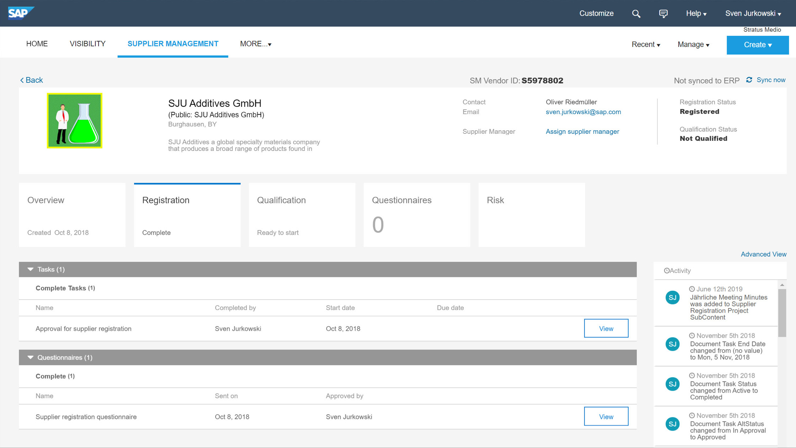
Integrate the entire source-to-settle process.
1
Manage suppliers more effectively.
Centralize direct, indirect, and services supplier information.
Get a 360-degree view of suppliers.
Improve qualification and oversight process.
Notes:
Manage suppliers more effectively:
Deliver, comprehensive supplier and policy management for indirect goods and services, because SAP centralizes spending across sources and suppliers in one place.
Get a single, centralized, 360-degree view of suppliers to improve the supplier qualification and management processes.

Slide 10
Integrate the entire source-to-settle process.
1
Effectively and efficiently manage cost accounting and payments plus do in-depth spend analysis.
Efficiently connect to suppliers.
Integrate across SAP spend management solutions.
Support multiple back-end environments.
Connect critical data and processes with out-of-the-box S/4 HANA integration.
Notes:
Connect to suppliers and to your systems more efficiently, using Cloud Integration Gateway to integrate your systems, processes, and trading partners with simplicity and speed:
Integrating SAP spend management solutions from across your company.
Supporting multi-ERP/back-end environment.
And taking advantage of out-of-the-box integrations with S/4 HANA to allow all critical data and information from invoices, payments, and more to integrate with your accounting system.
As a result, you can effectively and efficiently manage cost accounting and payments plus do in-depth spend analysis because all of your indirect spending data is integrated with all of your other spending and financial information, all in one place.

Slide 11
Integrate the entire source-to-settle process.
1
Make compliance easy for everyday users.
Integrate the buying process with contract compliance.
While increasing adherence to policy.
Without increasing demands on your team.
Notes:
Make compliance easy for everyday users by integrating the buying process with contract compliance to increase adherence to policy without increasing the demands on your procurement team.

Slide 12
INTERNAL ONLY
Many organizations consider services as a part of their indirect spend. As a result, the following slide introduces our services story.
Please use this slide if you feel it's appropriate for your audience and your conversation.
For more specific information about services, you can use the services content:
L0 Deck : How SAP Fieldglass complements SAP Ariba (Black)
L0 Deck : How SAP Fieldglass complements SAP Ariba(White)
Infographic : A quick look at the external workforce
GTM FAQ

Slide 13
Integrate the entire source-to-settle process.
1
Tackle the unique requirements of services.
Source and select who is performing the services.
Dynamic scoping based on how, where and when work will be delivered.
On- and off-boarding of resources, chain of custody tracking, tenure, project SLA, and performance.
Task- and activity-level cost accounting and effort tracking.
Notes:
Tackle the unique requirements of services to actively manage:
Sourcing and selecting who is performing the services – their expertise, specialties and certifications.
Dynamic scoping based on how, where and when work will be delivered.
On- and off-boarding of resources as well as chain of custody tracking, tenure and both project SLA, and performance.
Task- and activity-level cost accounting and effort tracking.

Slide 14
Embed intelligence from beginning to end.
2
Notes:
2. Embed intelligence from beginning to end.
With all of that data in place, now you can put it to work – taking advantage of intelligent technology like AI, machine learning and more to reinvent processes and eliminate unnecessary steps.

Slide 15
Embed intelligence from beginning to end.
2
Spend Analysis: Deliver insights into your buying behavior.
See how much you’re spending among families of suppliers.
Identify savings leaks, price variations, and purchasing overlaps.
Less than 20%
of procurement leaders are leveraging Machine Learning, Artificial Intelligence or predictive analytics solutions.*
Determine which suppliers can help you achieve diversity and sustainability.
Compare spend with industry peers.
*2019 CPO Survey: University of Mannheim Business School and SAP Ariba
Notes:
Despite the promise of these technologies, few organizations are taking advantage. A recent University of Mannheim study of procurement leaders found that less than 20% of respondents are leveraging Machine Learning, Artificial Intelligence or predictive analytics solutions.
But these technologies are available and applicable to indirect procurement today.
For example, Spend Analysis gathers your spend data from wherever it lives, classifies it according to company and industry standards, then enriches it with Dun & Bradstreet market intelligence using Machine Learning to deliver insightful analysis of your business buying behavior, including:
How much you’re spending among families of suppliers
Where savings leak, prices vary, and purchasing overlaps
Compare your spend to that of your industry peers
You can also see which suppliers can help you achieve diversity and sustainability – and more.

Slide 16
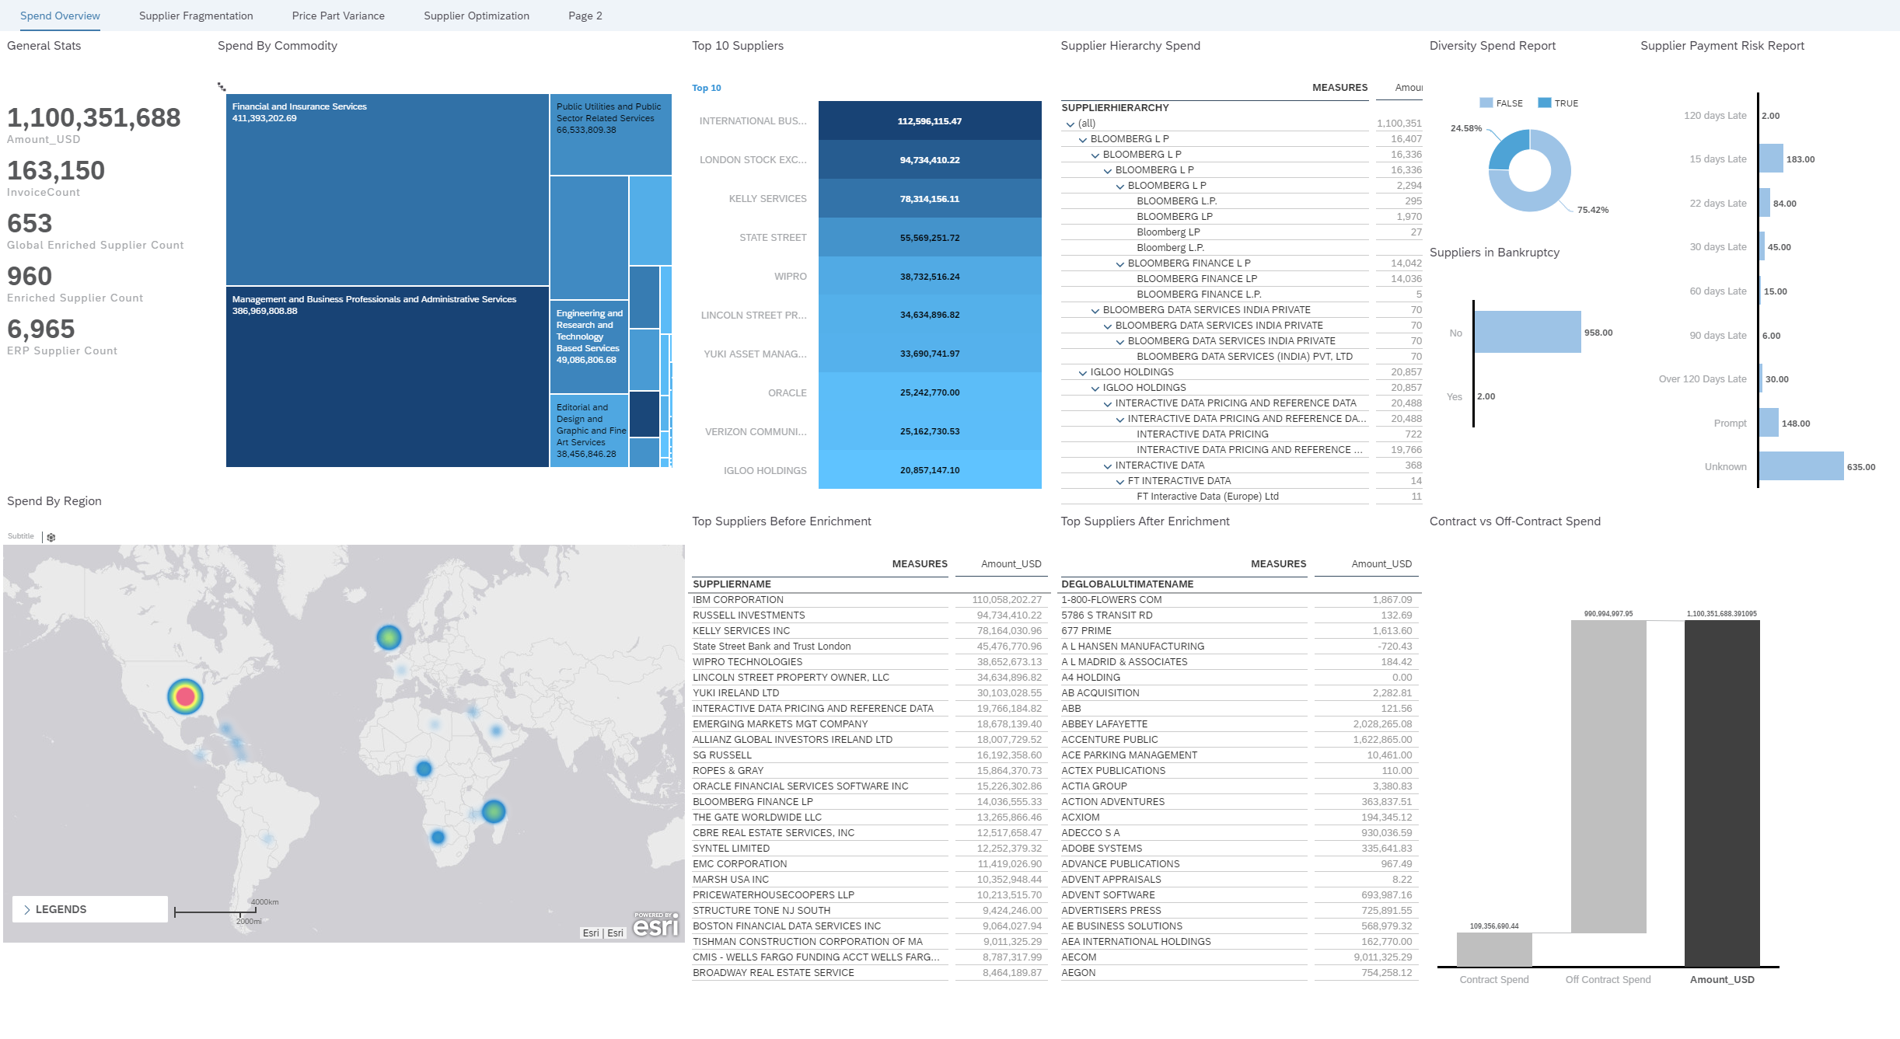
Embed intelligence from beginning to end.
2
SAP Analytics Cloud: Use AI, ML and NLP to improve decision making.
Uncover trends, plan for success, and execute on strategies.
Reveal new insights and simplify access to information.
Discover opportunities to get more return from suppliers.
Run what-if scenarios and simulations to improve planning.
Notes:
SAP Analytics Cloud brings together business intelligence (BI) and planning—enhancing those capabilities with machine learning and artificial intelligence to help you and your teams work smarter.
Working with SAP, you can complete an integration that takes advantage of built-in connection points between SAP Analytics Cloud and SAP Ariba, allowing you to see value faster and increase both the quality of decisions across your organization by:
Using augmented analytics to uncover new trends, plan for success, and execute and access strategies.
Uncover previously unseen insights with machine learning and simplify access to critical information with natural language processing.
Discover opportunities to get more return from your suppliers.
Run “what-if” scenarios and simulations to improve the effectiveness of planning.
cohesive platform offers a faster time to value, while giving the customers the confidence to take the next best action through informed decision making,
using augmented analytics.
In the intelligence era, organizations need to have seamless integration between all applications and technology to be able to act quickly.
Note: current integration of SAP Ariba and SAP Fieldglass Spend Management solutions is on project-basis (not included in standard shipments).

Slide 17
Embed intelligence from beginning to end.
2
What’s Next: Use AI and Machine Learning in contract creation, negotiation, structuring and execution.
Give users smart guidance as they create contracts.
Identify critical missing elements.
Recommend clauses and terms based on best practices, contract attributes and other parameters.
Notes:
And that’s just the beginning. In the future, we’ll:
Leverage AI and ML in contract creation, negotiation, structuring and execution, so we can deliver faster contract turnaround, improved compliance and reduced risk exposure.
We’ll give users smart guidance as they create contracts—identifying critical missing elements or recommending clauses and terms based on your organization’s best practices, contract attributes and other parameters. For example, the system will automatically recognize that an insurance level is too low, and not only recommend a change, but also explain why.

Slide 18
Redefine supplier oversight, collaboration and competition.
3
Notes:
3. Redefine supplier oversight, collaboration and competition.
Procurement is about collaboration – it’s about building productive, efficient, collaborative relationships with suppliers. Ariba Network is where businesses connect, communicate and collaborate to redefine how work gets done.

Slide 19
Redefine supplier oversight, collaboration and competition.
3
Ariba Network: Drive savings and efficiency through closer connections with millions of suppliers.
Automatically apply compliance polices to every transaction.
Use benchmarks and insights to measure your performance.
Generate competition in key categories to drive down costs.
Notes:
Ariba Network replaces cumbersome EDI and one-off portals for supplier collaboration with a powerful digital supplier network that facilities intelligent collaboration with all of your suppliers all in one place.
Ariba Network also infuses intelligence across the entire supplier collaboration process – from sourcing, contracts and requisitioning to invoicing and payment – automatically applying compliance polices to every transaction, while delivering both benchmarks and insights to measure your performance.
Competition drives down cost, but, if you’re like most organizations, you may not have an on-demand set of suppliers across all your categories. And finding new suppliers to augment those you have in place isn’t as simple as it sounds. But if you don’t, how do you know you’re getting the best prices or if there are some savings to be found? The Ariba Network gives you direct access to millions of suppliers – in 2018 alone, 4.1+ million companies shared 250+ million documents on the Network, so you have the opportunity to generate competition in key expense categories where you may not have had it before to help drive costs down.

Slide 20
Redefine supplier oversight, collaboration and competition.
3
Supplier Risk: Proactively manage risk throughout your supply chain.
Automatically scan and screen data from more than 600,000 media and other sources.
Use AI to create automatic alerts for operational, financial, environmental and social, regulatory and legal risks.
Actively work with suppliers to mitigate risks and protect your supply chain and your brand.
Notes:
Supplier Risk automatically integrates independent, third-party risk data to assess risk in your supply chain.
The solution scans and screens data from more than 600,000 media and other sources, using AI to create automatic supplier risk alerts for operational, financial, environmental and social, regulatory and legal risk incidences.
Using proactive alerts, incident trends and risk exposure metrics, you can see to any change in risk status and have the insight you need to actively work with suppliers to mitigate risks and protect both your supply chain and your brand.

Slide 21
Engage and guide buyers with dynamic experiences.
4
Notes:
4. Engage and guide buyers with dynamic experiences.
A bad experience pushes users away, and corporate mandates that force employees to use clunky, cumbersome systems aren’t realistic anymore. So if any system or software is too difficult, it won’t get used – no matter how much training, communication and begging you do.

Slide 22
Engage and guide buyers with dynamic experiences.
4
A digital experience that users actually want to use.
Step-by-step purchasing process, so it’s incredibly simple.
Customized suppliers, commodities, and processes for each user.
Move transactions automatically through approval processes.
Diverse catalogs—setup and managed by suppliers, not your team.
Notes:
SAP Ariba has designed a digital experience that makes users want to, well, use it, and:
Guide them through the correct purchasing process step-by-step, so it’s incredibly simple.
Serve up customized suppliers, commodities, and processes for each user.
Move transactions automatically through approval processes, so they’re not wasting time chasing down requests.
Give them one place to find exactly what they need – for indirect purchases and categories of expenses that haven’t been sourced by procurement.
Offer diverse catalogs—setup and managed by suppliers, not your team—that make it easy for users to find what they need, within policy.
It’s a one-stop, simple-to-use destination that keeps users coming back, and that’ll keep them compliant.

Slide 23
Capture and control tail spend.
5
Notes:
5. Capture and control tail spend
One-off, high-price-point purchases are difficult to manage for most procurement organizations – as are large-volume, lower-price-point expenses that look small individually, but add up to big numbers. Because these expenses are hard to control, it’s hard to know if you’re leaving money on the table.

Slide 24
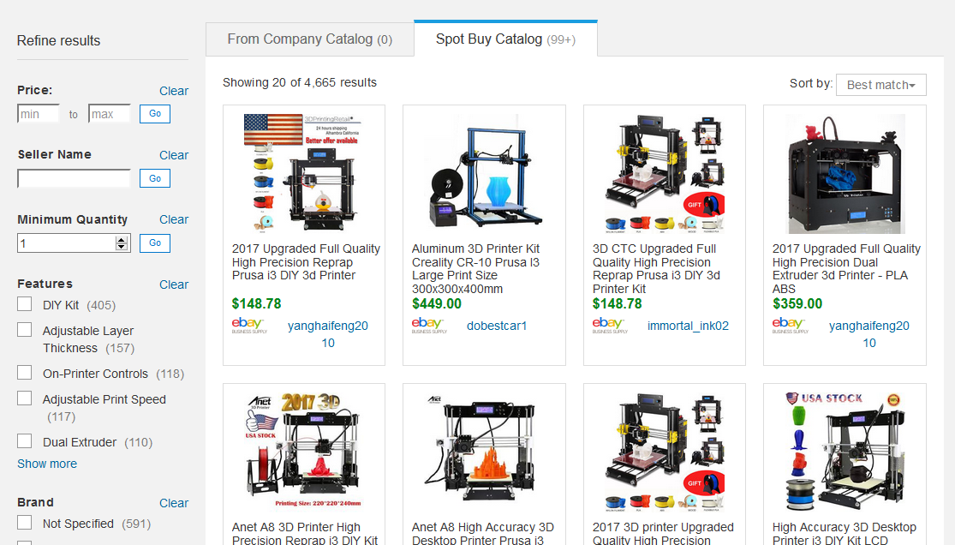
Capture and control tail spend.
5
Get control of one-off purchases without adding complexity.
Give users a quick and easy way to choose from more than 100 million items.
Access marketplaces like eBay Professional, Mercateo and Mercado Libre customized to your policies.
Guide them through a three-bids-and-a-buy process, so they can manage it on their own.
Notes:
With SAP Ariba, you can equip employees with simple tools they can use to manage this spending within policy and without involving your team.
Spot Buy* gives users a quick and easy way to choose from more than 100 million items, giving access to marketplaces like eBay Professional, Mercateo and Mercado Libre in a single, consumer-simple shopping experience that’s customized to match your policies and processes.
And you can empower users with simple tools that guide them through a three-bids-and-a-buy process, so they can manage it on their own.

Slide 25
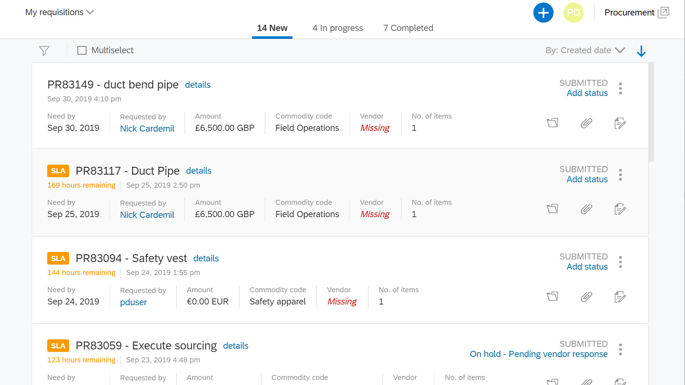
Capture and control tail spend.
5
Turn manual requests into a digital, automated process.
Easily track all source-to-settle requests in one place.
Automatically assign and route requests to the right person.
Meet SLA’s by monitoring and load balancing workflows.
Analyze and report on shared service KPI’s.
Notes:
And Procurement Operations Desk takes manual requests and turns them into a digital, automated process, giving your procurement shared services team a one-look view to manage their queue of inquiries, POs, sourcing events, etc.
You can easily assign requests to the right person, equip teams to collaborate and manage deadlines, and provide transparency along the way.
As a result, your team to scale to meet growing volumes of source-to-settle requests while meeting you SLAs.

Slide 26
Wrapping up:
A look at today’s results.
39% lower maverick spend.
48% higher compliant PO spend.
67% lower PO processing costs.
74% faster PR to PO cycle time.
$78,000 of savings per
10,000 POs processed.
Source: SAP Ariba Benchmarking Study
Notes:
Wrapping up: Today’s results and a vision for tomorrow.
By creating a fully intelligent procurement process with SAP, you can increase the control and efficiency the business is asking for. You can build on your success and continually bring more value to the business. Our benchmarking shows that our customers have seen:
39% lower maverick spend.
48% higher compliant PO spend.
67% lower PO processing costs.
74% faster PR to PO cycle time.
$78,000 of savings per 10,000 POs processed.

Slide 27
Wrapping up:
In the words of our customers.
The biggest benefit of SAP Ariba has been process automation where we have seen 45% of procurement-related processes automated.
- Michal Szlezak, Indirect Procurement Manager, Eastern European Regions, Danfoass A/S
Guided Buying is a really great application for McKesson. [We use it] as our single point of entry into all of our sourcing and procurement systems. It guides them to the make smart purchasing decisions.
- Michale Tokarz, Senior Director Source to Pay, McKesson Corporation
With SAP Ariba, Bridgestone has unified purchasing process and policies across the organization reaching 100% control an reporting of indirect spend.
With SAP Ariba, utility company, National Grid, is able to manage 100% of its suppliers through the system and saw $2.2 million in savings in the first year.
Notes:
Danfoss Case Study: https://www.ariba.com/resources/library/library-pages/danfoss-bts
McKesson Case Study: McKesson Corp: https://www.ariba.com/resources/library/library-pages/mckesson-bts
For Bridgestone and National Grid visit the Customer Reference Platform: https://crpa4c19efc4.hana.ondemand.com/cat/ci/cip/#/assets/details/SAP227612

Slide 28
INTERNAL ONLY SLIDE: REMOVE BEFORE SHARING WITH CUSTOMERS.
SAP Ariba Team: Slides 26-28 operated as a single slide with automatic transitions, presenting a glimpse of our future strategy and evolution of the category.
Slide 30 (in the Appendix) is a simpler, single-slide version of the same story.
Please choose whichever option you feel most comfortable presenting and is most appropriate for your audience.

Slide 29
Wrapping up:
A vision for tomorrow.
Digital- and Intelligence-Driven Procurement
Notes:
But this is just the beginning. Together, we’re on a journey that’s transforming procurement today and continuing to invest in what’s next for this critical process.
As we’ve discussed, today:
We offer a fully integrated source-to-settle process across indirect goods and services, packed with real-time analytics and collaboration within your organization and with suppliers.
We infuse intelligence wherever possible – offering proactive insights, machine-learning-driven recommendations, predictive analytics, digital assistants and more.
And we’ll continue to invest in intelligence to:
Embed AI throughout the process to further guide and prompt users and shift from drilling down into detail to proactively surfacing alerts for users.
Use Natural Language Processing instead of cryptic, pre-defined terminology to navigate the solution and complete tasks.
Use AI-powered mapping and translation to integrate processes.

Slide 30
Wrapping up:
A vision for tomorrow.
Digital- and Intelligence-Driven Procurement
Fully-Automated Procurement
Notes:
And as we look into the future, we can progress to fully automated procurement where:
Automated steps are driven by machine learning.
Robotic Process Automation (RPA) takes care of recurring tasks.
Continuous auditing via Block chain is an everyday reality.

Slide 31
Wrapping up:
A vision for tomorrow.
Digital- and Intelligence-Driven Procurement
Fully-Automated Procurement
Autonomous Procurement
Notes:
Then move to autonomous procurement where:
We see autonomous operational procurement processes and sourcing decisions driven by RPA and machine learning.
Advanced artificial intelligence (AI) bots, with robotic process automation (RPA)-like capabilities, work from large pools of data to remove people from the procurement processes like:
Automatically creating purchase requisitions for indirect goods and services, then sending them to the user for confirmation.
Or autonomous source selection for purchase requests with no supplier.
Or autonomous sourcing events to fill demand when no supplier is available in the supply base.
Strategic decisions are carried out by intelligent assistants, and proactive procurement decisions are made through conversational chatbots.
This is not some far-off, unattainable future – it’s a reality that’s within our reach. And by embracing digitalization and intelligence today, you can prepare yourself and your business for this future.

Slide 32
Intelligent Spend Management
Travel & Expense
Direct
Indirect
Services
Notes:
Finally, when your total vendor spending comes together – direct, indirect, T&E, services and external labor – you can bring finance and procurement leaders together to get control of each spend category and give the business the power to orchestrate spending and processes across categories.

Slide 33
Intelligent Spend Management
Every source. Every category. One unified view
Direct
Comprehensive
Policy and Supplier
Management
Services
Indirect
Unified View
of Spending
Travel & Expense
Notes:
With SAP, you can put the best-in-class solution for each spend category to work for your business.
You can capitalize on decades of experience, learning and innovation within each category, while connecting to unmatched supplier networks and ecosystems of third-party solution provider.
You can capture spending from inside and outside traditional channels, centralizing once-invisible spend, applying policies consistently and bringing more spend under management.
And you can bring spending data together from across categories, delivering full transparency into costs for projects, products or business units, plus the insights and recommendations on the next best action to take.
So while your focus today may be indirect, by partnering with SAP, you position yourself to tackle each and every category of spend in an integrated, efficient and intelligent way.

Slide 34
Appendix

Slide 35
Wrapping up:
A vision for tomorrow.
Digital- and Intelligence-Driven Procurement
Fully-Automated Procurement
Autonomous Procurement
Notes:
But this is just the beginning. Together, we’re on a journey that’s transforming procurement today and continuing to invest in what’s next for this critical process.
As we’ve discussed, today:
We offer a fully integrated source-to-settle process across indirect goods and services, packed with real-time analytics and collaboration within your organization and with suppliers.
We infuse intelligence wherever possible – offering proactive insights, machine-learning-driven recommendations, predictive analytics, digital assistants and more.
And we’ll continue to invest in intelligence to:
Embed AI throughout the process to further guide and prompt users and shift from drilling down into detail to proactively surfacing alerts for users.
Use Natural Language Processing instead of cryptic, pre-defined terminology to navigate the solution and complete tasks.
Use AI-powered mapping and translation to integrate processes.
And as we look into the future, we can progress to fully automated procurement where:
Automated steps are driven by machine learning.
Robotic Process Automation (RPA) takes care of recurring tasks.
Continuous auditing via Block chain is an everyday reality.
Then move to autonomous procurement where:
We see autonomous operational procurement processes and sourcing decisions driven by RPA and machine learning.
Advanced artificial intelligence (AI) bots, with robotic process automation (RPA)-like capabilities, work from large pools of data to remove people from the procurement processes like:
Automatically creating purchase requisitions for indirect goods and services, then sending them to the user for confirmation.
Or autonomous source selection for purchase requests with no supplier.
Or autonomous sourcing events to fill demand when no supplier is available in the supply base.
Strategic decisions are carried out by intelligent assistants, and proactive procurement decisions are made through conversational chatbots.
This is not some far-off, unattainable future – it’s a reality that’s within our reach. And by embracing digitalization and intelligence today, you can prepare yourself and your business for this future.

